Slide 1
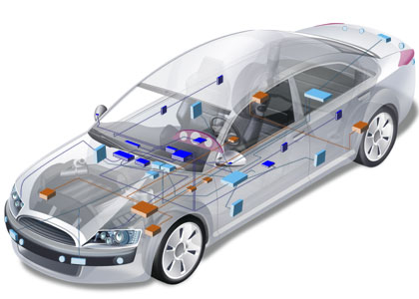

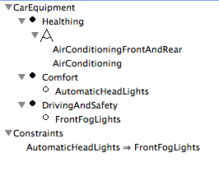

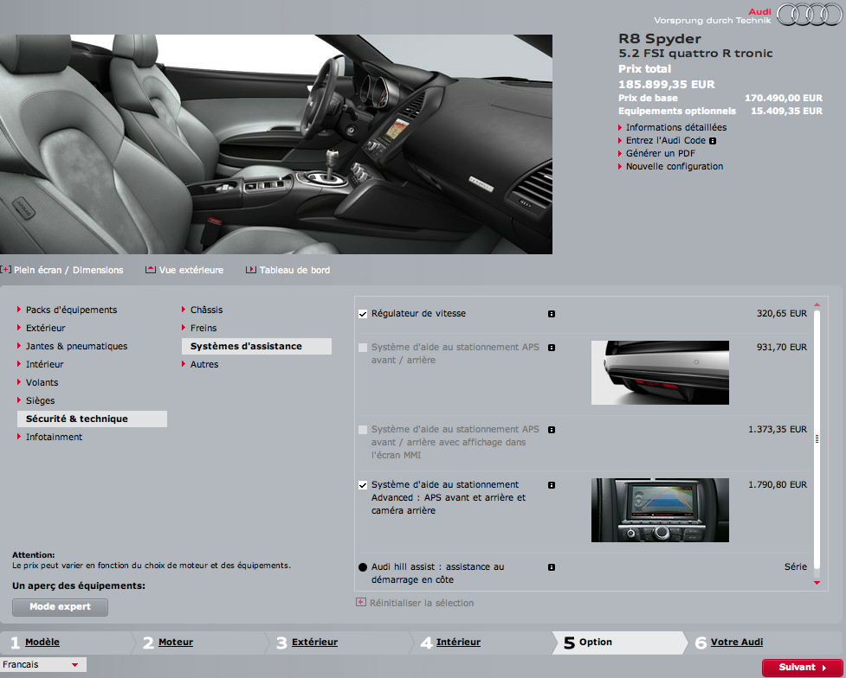



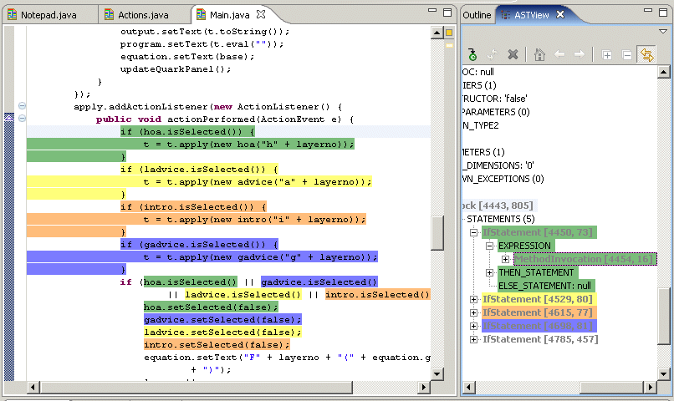


Model-based
Software Product Lines
Variability Models (Part 2)
Mathieu Acher
Maître de Conférences
mathieu.acher@irisa.fr
Notes:
Thank you.
Before entering in the technical details of my PhD thesis (entitled “…”), I would like to start this presentation with an intuitive overview of what have been my research work during the last three years.

Slide 2
Material
http://mathieuacher.com/teaching/M2R/

Slide 3
Previously

Slide 4
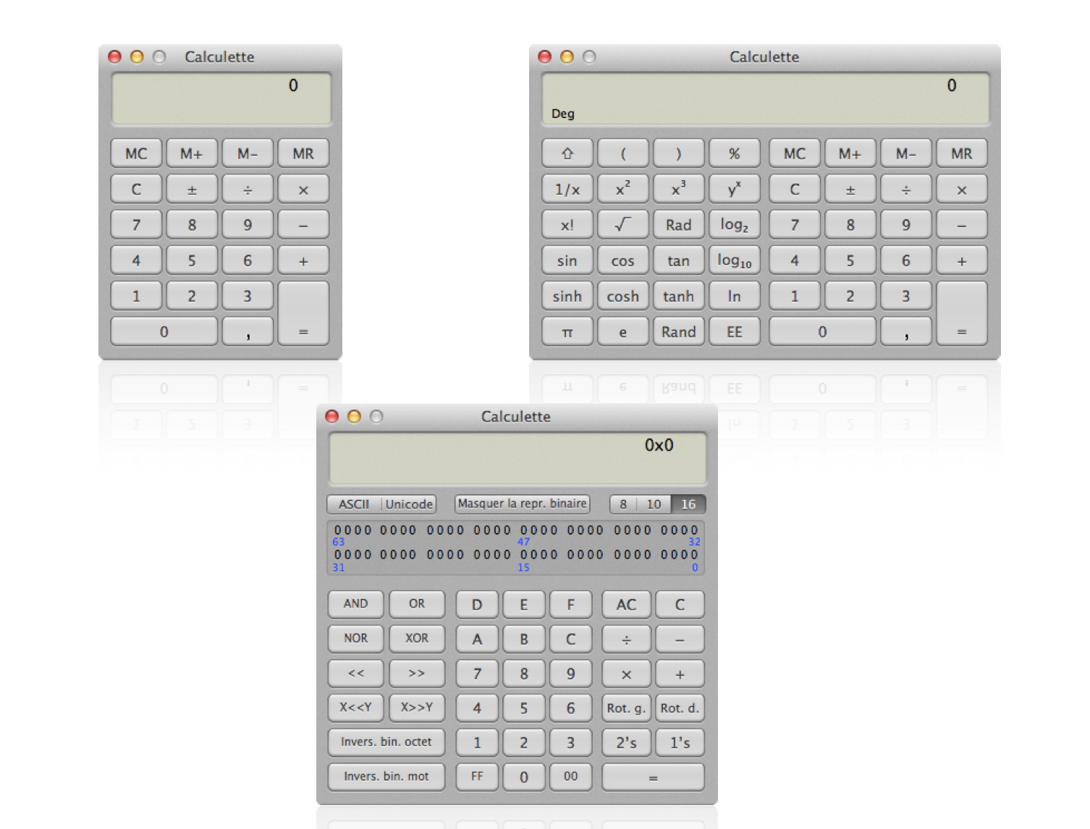


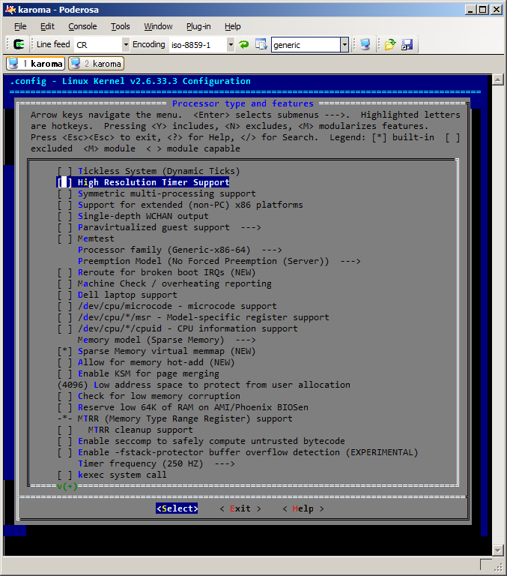

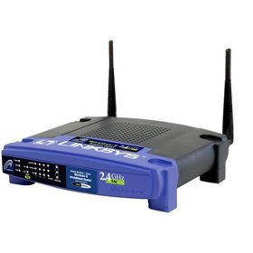

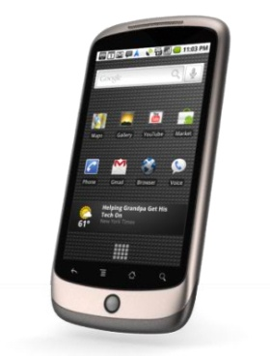
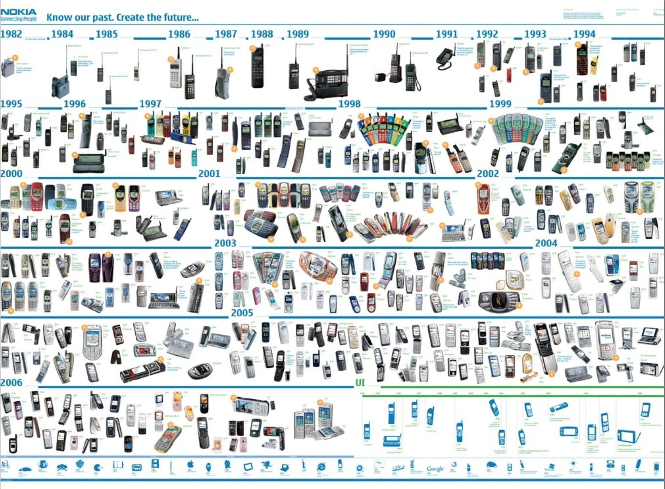
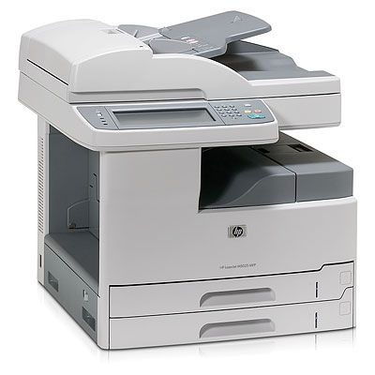
Linux Kernel
2000 features

Slide 5
Software Product Line Engineering
Factoring out commonalities
for Reuse [Krueger et al., 1992] [Jacobson et al., 1997]
Managing variabilities
for Software Mass Customization [Bass et al., 1998] [Krueger et al., 2001], [Pohl et al., 2005]
Notes:
By analogy with the product lines of automotive industry, there are software product lines
TODO: change the pictures (VS + Medical imaging domain)
State that “mobile phone” is just an example
Software systems.

Slide 6
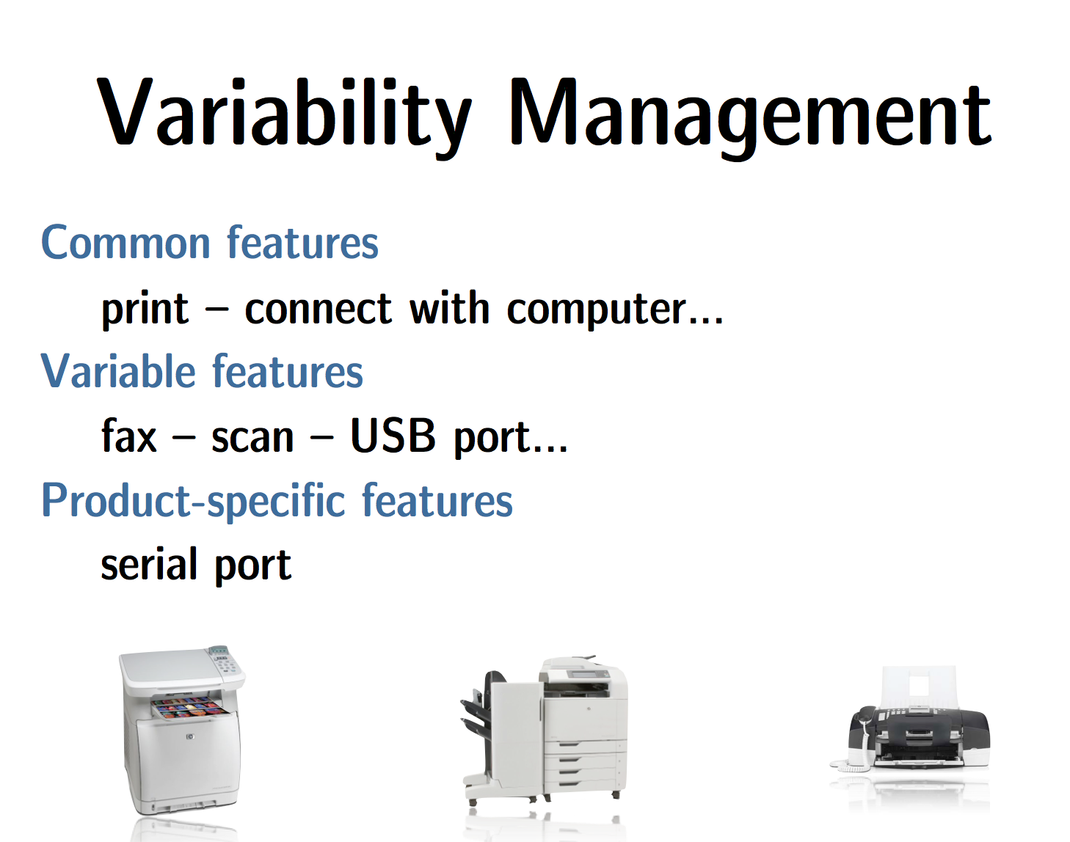

Slide 7
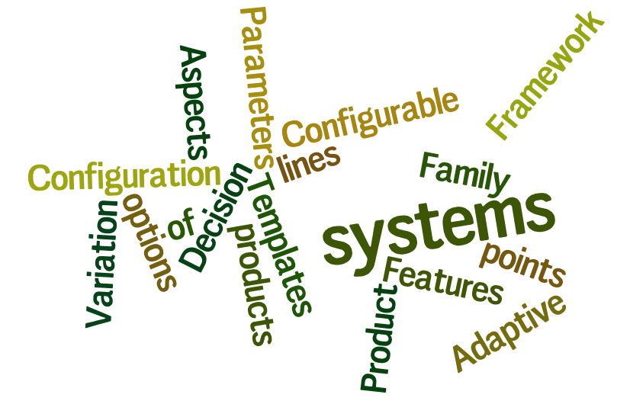
Variability
“the ability of a system to be efficiently extended, changed, customized or configured for use in a particular context”
Mikael Svahnberg, Jilles van Gurp, and Jan Bosch (2005)

Slide 8


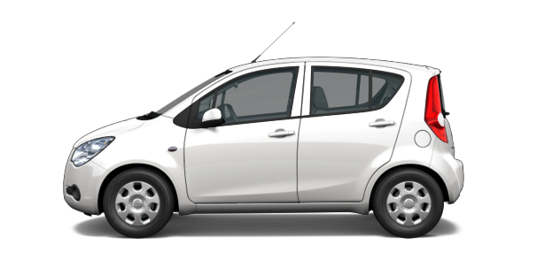
Domain engineering (development for reuse)
Common assets
Variants
Variability Model
Reusable Assets
(e.g., models or source code)
Configurations
product₁
product₂
product_{n}
Configuration
Application engineering (development with reuse)
Notes:
Focus sur le scope de la thèse, et ne pas dire “on ne va pas parler de….”

Slide 9
Modeling Variability:
Why Should I Care?

Slide 10
Variability Models
Notes:
Or-group
An excerpt of the medical imaging analysis domain…… (justify)
Ref sur les feature models
A feature model is a hierarchy of features with variabilty
The primary purpose of the hierarchy is to organize features into multiple levels of increasing detail
Variability deﬁnes what the allowed combinations of features are.
Variability in a feature model is expressed through different mechanisms.
describes a set of valid feature combinations.

Slide 11
#1 precise specification is needed

Slide 12




Modeling variability
is crucial
Variability Model
Domain Artefacts (e.g., source code)
✓
✓
Configuration
Software Generator

Slide 13
Domain engineering (development for reuse)
Common assets
Variants
Variability Model
Reusable Assets
(e.g., models or source code)
Configurations
product₁
product₂
product_{n}
Feature Configuration
Application engineering (development with reuse)
Notes:
Focus sur le scope de la thèse, et ne pas dire “on ne va pas parler de….”

Slide 14
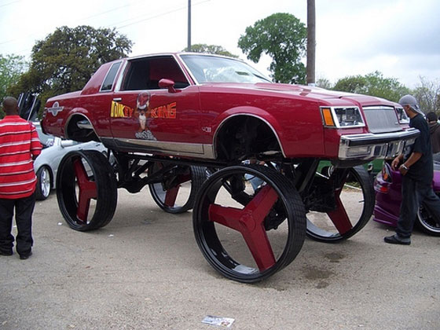
Illegal variant

Slide 15
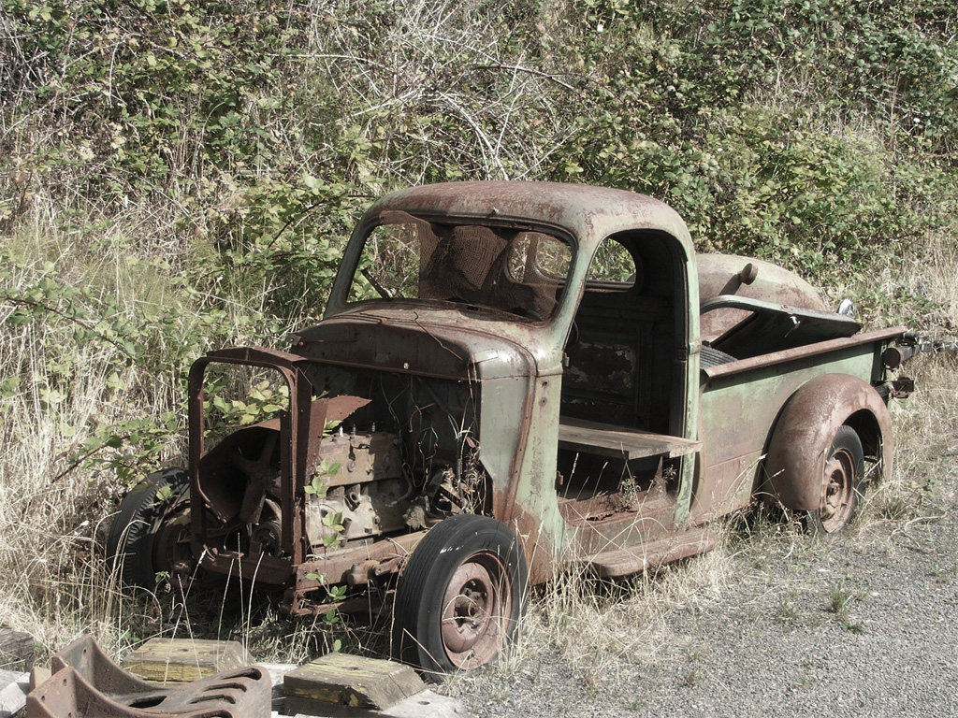
Unused flexibility

Slide 16
#2 variability cross cuts all artefacts (from requirements to code)

Slide 17
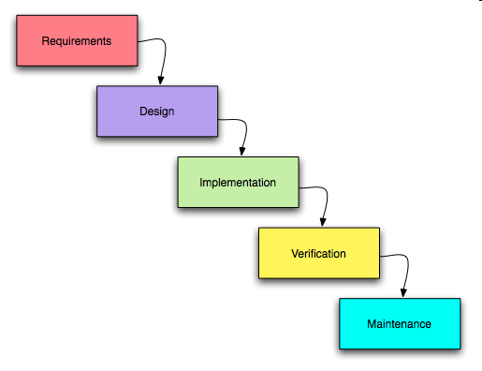

Slide 18
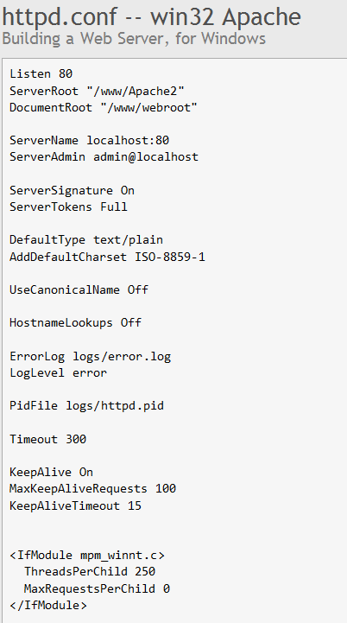

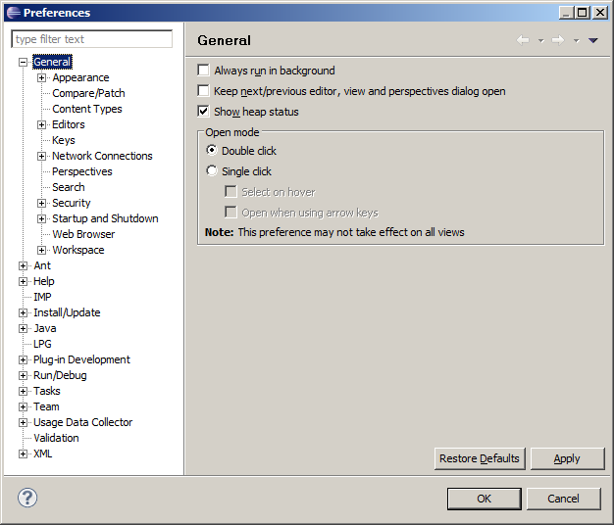
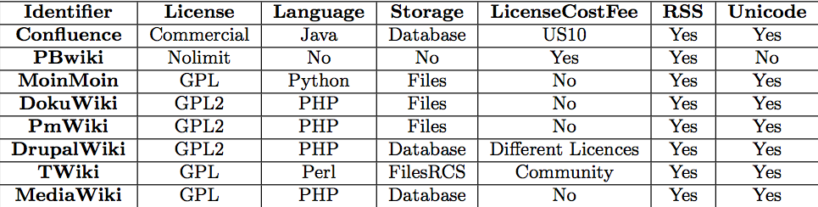

Slide 19
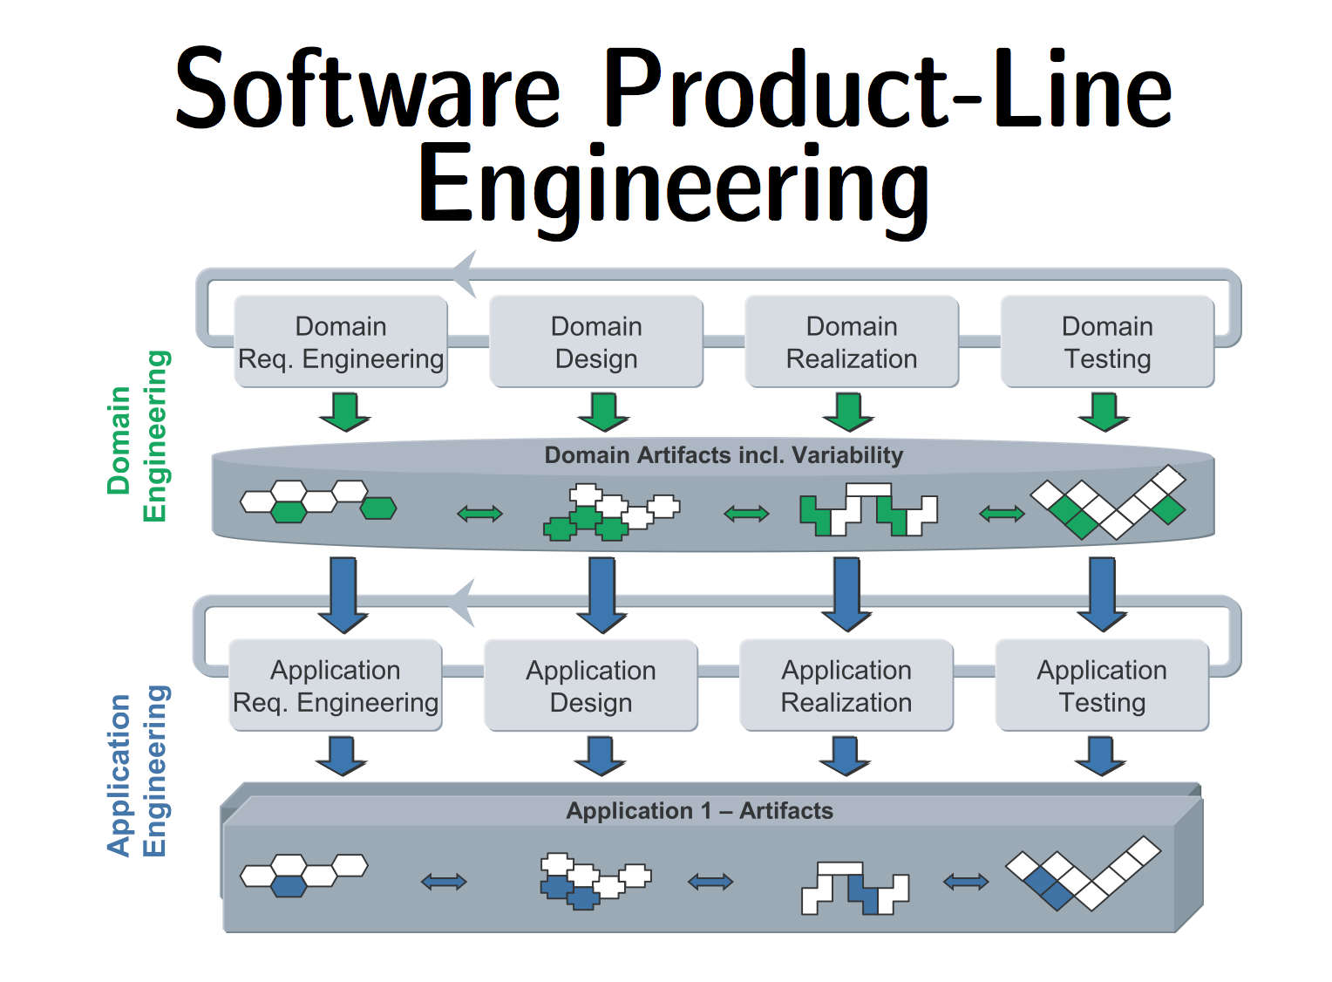

Slide 20
#3 automation
(exponential number of products)

Slide 21

Variability = Complexity
Kästner’s slide

Slide 22

33 features
optional, independent
a unique variant for every
person on this planet
Kästner’s slide

Slide 23

320 features
more variants than estimated
atoms in the universe
optional, independent
Kästner’s slide

Slide 24
10000
2000 features
features

Slide 25
Variability Model
Abstraction of some aspect of a system under study (SUS)
  Some details are hidden or removed to simplify and focus attention
  general concepts can be formulated by abstracting common properties of instances
In a form that can be mechanically analyzed
  properties of a SUS
  model transformation
    Generation of another abstraction (including code)

Slide 26
Variability Models: Why?
(3 arguments, summary) precise specification variability is orthogonal / cross cuts different artefacts automation

Slide 27
Variability models are needed. Now we are convinced…
#1 Formalism? Theory? modeling principles, semantics, logics
#2 Language? to elaborate/build variability models
#3 Reasoning techniques? to analyze properties of an SPL (scalable and automated way)
#4 Applications of variability models? variability model and so what?

Slide 28
Feature models,
the defacto standard
for modeling variability

Slide 29
Feature Models
Variability and Configuration
29

Slide 30

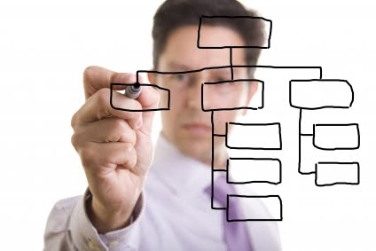
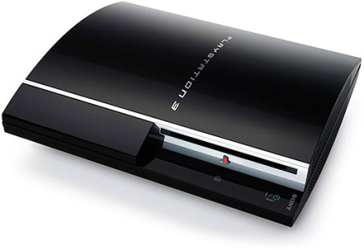
Feature Model
Communicative
Analytic
Generative

Slide 31
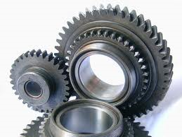


Feature Model de facto standard
Research
  2500+ citations of [Kang et al., 1990] on Google Scholar
  Central to many generative approaches
    at requirements or code level
  Tools & Languages (GUIDSL/FeatureIDE, SPLOT, FaMa, FAMILIAR)
Industry
  Tools (Gears, pure::variants),
Common Variability Language (CVL)
φ

Slide 32
Feature Model: Applications
Domain Analysis
Configurators
Automated Derivation of “Product”
Testing
Model Checking
Notes:
I chose feature model because it is recognized as the de facto standard for modeling variability.
It is used in ….
(attention, bien répéter ce slide)

Slide 33
Feature Models:
Principles

Slide 34
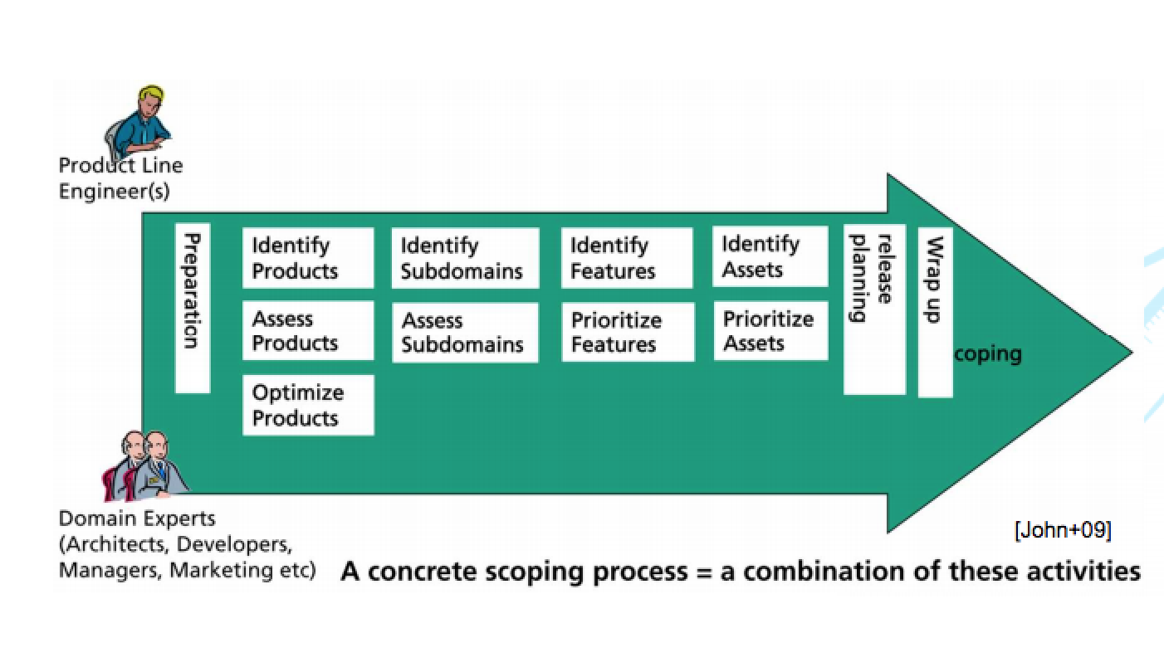
Feature modeling is…
… about identifying
  common features of concepts
  variable features of concepts
  and their dependencies
  and documenting them in a coherent model, called a feature model
Core activity of domain-engineering methods

Slide 35
Feature and Psychology
The human mind processes lots of information
Important function of human information processing: reducing the amount of information
Describing concepts by features
  Clustering
  Abstraction (Classification/Generalization)
  Vocabulary construction
Classifying a perceptional unit as an instance of a concept
Analysis of similarity
  Features common to entities, activities, events, relationships, structures, etc.
Analysis of variations
  Features that are unique to entities, activities, events, relationships, structures, etc.

Slide 36
Modeling variability (and commonality)
Features are a convenient way to think about commonalities and differences between family members
  e.g. "MP3 player" – some phones have it, some don't
Features are « usually » coarse-grained abstractions
  Abstract from detailed requirements
    e.g. "when in shuffle mode, the player selects the next track using a random function"
  Abstract from design/implementation details
    e.g. "MP3_Player is a concrete subclass of Media_Player »
Depends on what you are modeling and for which purpose
  Elicitating requirements with customers (informal document)
  VS builiding a representation of your code (based on CPP directives)

Slide 37
What's a feature? (survey excerpt)
[Kang et al.] “a prominent or distinctive user-visible aspect, quality or characteristic of a software system or systems”
[Kang et al.] “distinctively identiﬁable functional abstractions that must be implemented, tested, delivered, and maintained”
[Eisenecker and Czarnecki]. “anything users or client programs might want to control about a concept”
[Bosch et al.] “A logical unit of behaviour speciﬁed by a set of functional and non-functional requirements.”
[Chen et al.] “a product characteristic from user or customer views, which essentially consists of a cohesive set of individual requirements”
[Batory] “an elaboration or augmentation of an entity(s) that introduces a new service, capability or relationship”
Requirements to Code

Slide 38
Feature Models:
Syntax

Slide 39
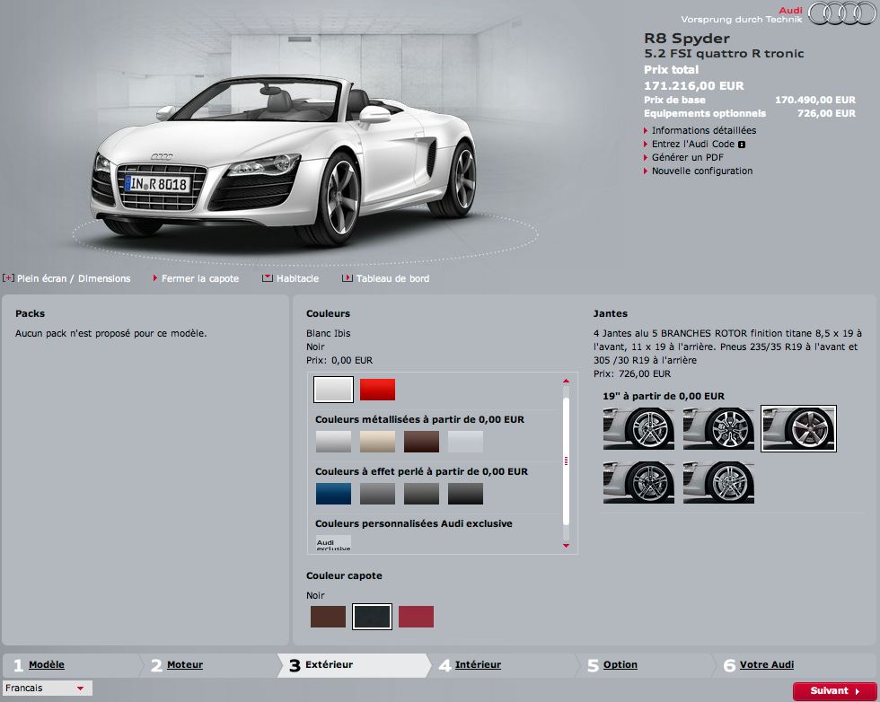

Slide 40


excludes

Slide 41
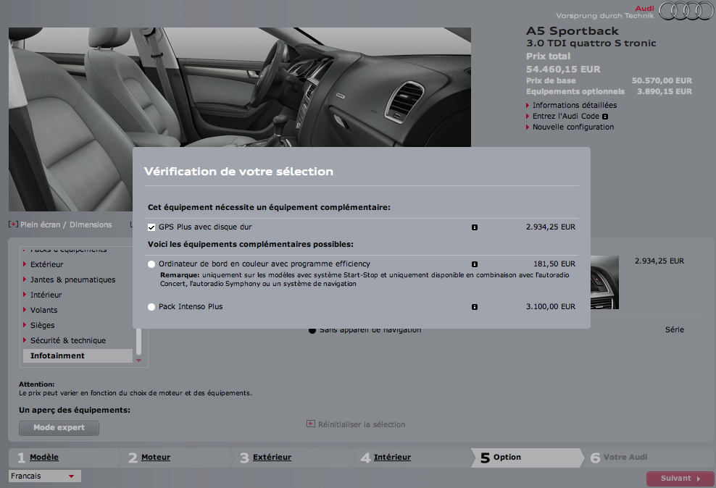

Slide 42
Feature Models
Notes:
Or-group
An excerpt of the medical imaging analysis domain…… (justify)
Ref sur les feature models
A feature model is a hierarchy of features with variabilty
The primary purpose of the hierarchy is to organize features into multiple levels of increasing detail
Variability deﬁnes what the allowed combinations of features are.
Variability in a feature model is expressed through different mechanisms.
describes a set of valid feature combinations.

Slide 43
Feature Models (Background)
Hierarchy: rooted tree
Variability:
mandatory,
optional,
Groups: exclusive or inclusive features
Cross-tree constraints
Notes:
Or-group
An excerpt of the medical imaging analysis domain…… (justify)
Ref sur les feature models
A feature model is a hierarchy of features with variabilty
The primary purpose of the hierarchy is to organize features into multiple levels of increasing detail
Variability deﬁnes what the allowed combinations of features are.
Variability in a feature model is expressed through different mechanisms.
describes a set of valid feature combinations.

Slide 44
✓
✓
✓
✓
✓
✓
✓
Hierarchy + Variability
=
set of valid configurations
configuration = set of features selected
{CarEquipment, Comfort, DrivingAndSafety, Healthing, AirConditioning, FrontFogLights}
Notes:
An excerpt of the medical imaging analysis domain…… (justify)
Ref sur les feature models
A feature model is a hierarchy of features with variabilty
The primary purpose of the hierarchy is to organize features into multiple levels of increasing detail
Variability deﬁnes what the allowed combinations of features are.
Variability in a feature model is expressed through different mechanisms.
describes a set of valid feature combinations.

Slide 45
✓
✓
✓
✓
✓
✓
Hierarchy + Variability
=
set of valid configurations
configuration = set of features selected
{CarEquipment, Comfort, DrivingAndSafety, Healthing, AirConditioning}
Notes:
An excerpt of the medical imaging analysis domain…… (justify)
Ref sur les feature models
A feature model is a hierarchy of features with variabilty
The primary purpose of the hierarchy is to organize features into multiple levels of increasing detail
Variability deﬁnes what the allowed combinations of features are.
Variability in a feature model is expressed through different mechanisms.
describes a set of valid feature combinations.

Slide 46
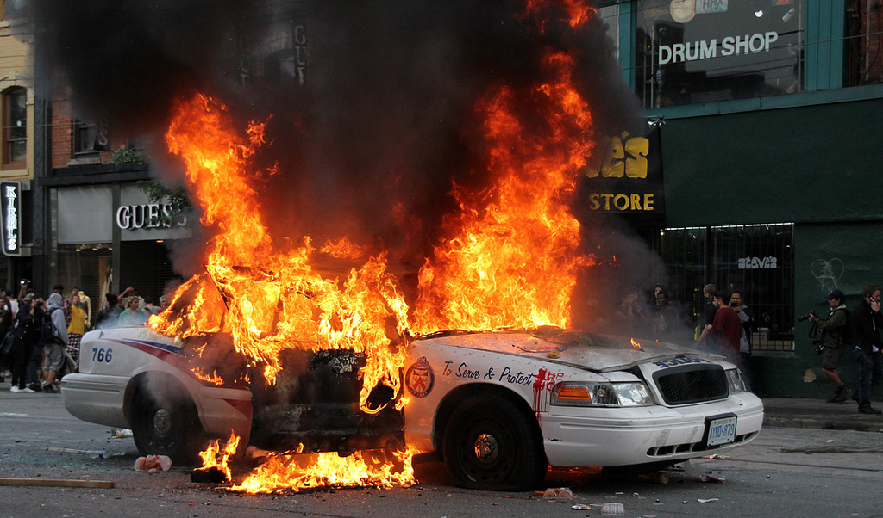
✓
✓
✓
✓
✓
✓
Hierarchy + Variability
=
set of valid configurations
configuration = set of features selected
{CarEquipment, Comfort, DrivingAndSafety, Healthing, AirConditioning, AirConditioningFrontAndRear, FrontFogLights}
Notes:
An excerpt of the medical imaging analysis domain…… (justify)
Ref sur les feature models
A feature model is a hierarchy of features with variabilty
The primary purpose of the hierarchy is to organize features into multiple levels of increasing detail
Variability deﬁnes what the allowed combinations of features are.
Variability in a feature model is expressed through different mechanisms.
describes a set of valid feature combinations.

Slide 47
✓
✓
✓
✓
✓
✓
✓
Hierarchy + Variability
=
set of valid configurations
configuration = set of features selected
{CarEquipment, Comfort, DrivingAndSafety, Healthing, AirConditioning,
AutomaticHeadLights}
Notes:
An excerpt of the medical imaging analysis domain…… (justify)
Ref sur les feature models
A feature model is a hierarchy of features with variabilty
The primary purpose of the hierarchy is to organize features into multiple levels of increasing detail
Variability deﬁnes what the allowed combinations of features are.
Variability in a feature model is expressed through different mechanisms.
describes a set of valid feature combinations.

Slide 48
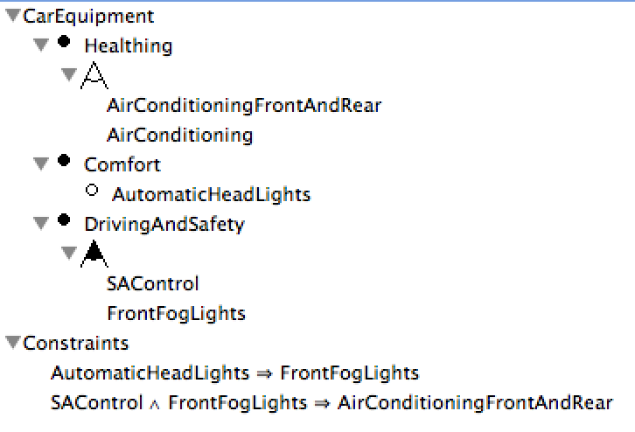
✓
Boolean logic: ^, v, not, implies
Hierarchy + Variability
=
set of valid configurations
Notes:
An excerpt of the medical imaging analysis domain…… (justify)
Ref sur les feature models
A feature model is a hierarchy of features with variabilty
The primary purpose of the hierarchy is to organize features into multiple levels of increasing detail
Variability deﬁnes what the allowed combinations of features are.
Variability in a feature model is expressed through different mechanisms.
describes a set of valid feature combinations.

Slide 49
✓
Hierarchy + Variability
=
set of valid configurations
Or-group: at least one!
Notes:
An excerpt of the medical imaging analysis domain…… (justify)
Ref sur les feature models
A feature model is a hierarchy of features with variabilty
The primary purpose of the hierarchy is to organize features into multiple levels of increasing detail
Variability deﬁnes what the allowed combinations of features are.
Variability in a feature model is expressed through different mechanisms.
describes a set of valid feature combinations.

Slide 50
✓
✓
Hierarchy + Variability
=
set of valid configurations
{AirConditioningFrontAndRear, FrontFogLights, SAControl}
{AirConditioningFrontAndRear, SAControl}
{AutomaticHeadLights, AirConditioning, FrontFogLights}
{AirConditioningFrontAndRear, SAControl, AutomaticHeadLights, FrontFogLights}
{FrontFogLights, AirConditioning}
{AutomaticHeadLights, AirConditioningFrontAndRear, FrontFogLights}
{FrontFogLights, AirConditioningFrontAndRear}
{SAControl, AirConditioning}
{CarEquipment, Comfort, DrivingAndSafety, Healthing}
X
Notes:
An excerpt of the medical imaging analysis domain…… (justify)
Ref sur les feature models
A feature model is a hierarchy of features with variabilty
The primary purpose of the hierarchy is to organize features into multiple levels of increasing detail
Variability deﬁnes what the allowed combinations of features are.
Variability in a feature model is expressed through different mechanisms.
describes a set of valid feature combinations.

Slide 51
Languages:
How to specify
feature models?

Slide 52
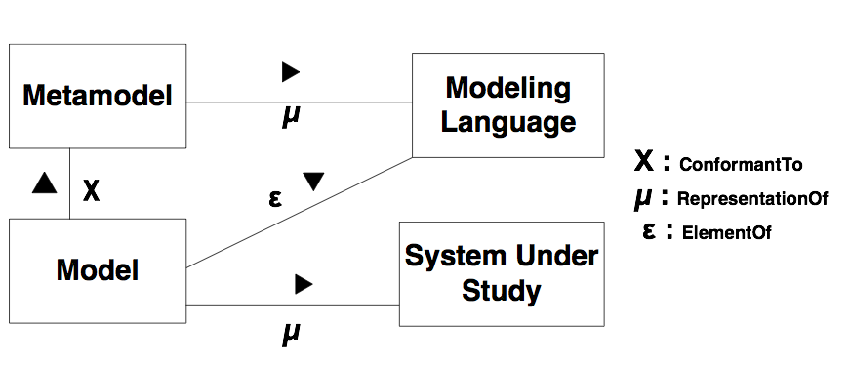
Feature Models
Notes:
Or-group
An excerpt of the medical imaging analysis domain…… (justify)
Ref sur les feature models
A feature model is a hierarchy of features with variabilty
The primary purpose of the hierarchy is to organize features into multiple levels of increasing detail
Variability deﬁnes what the allowed combinations of features are.
Variability in a feature model is expressed through different mechanisms.
describes a set of valid feature combinations.

Slide 53
History of Feature Models
~ often called Feature Diagrams
(suggest a visual representation) graphical languages

Slide 54
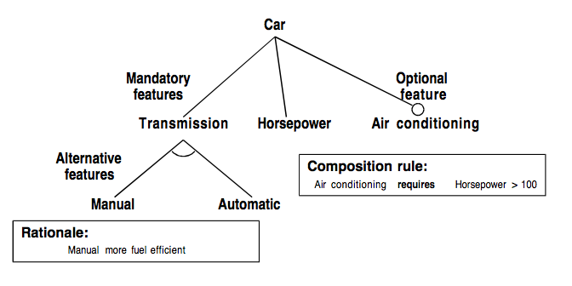
Feature Models
Kang et al. (1990)

Slide 55
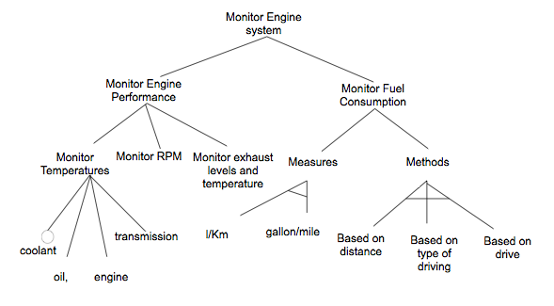
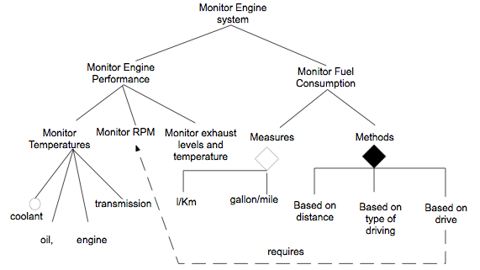
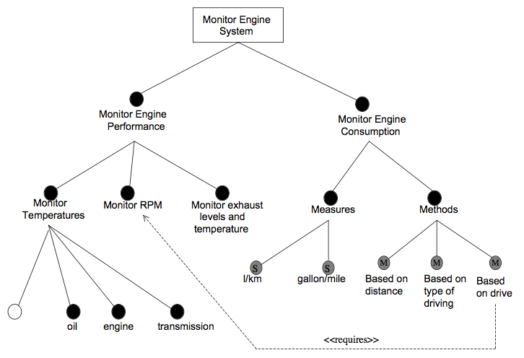
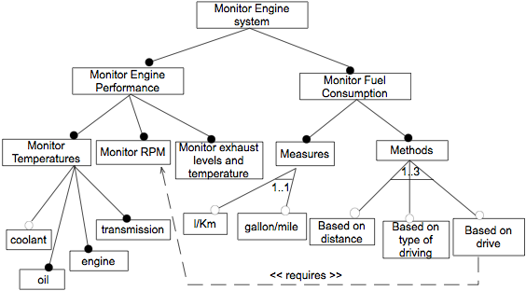
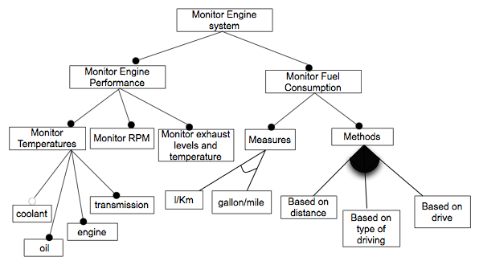
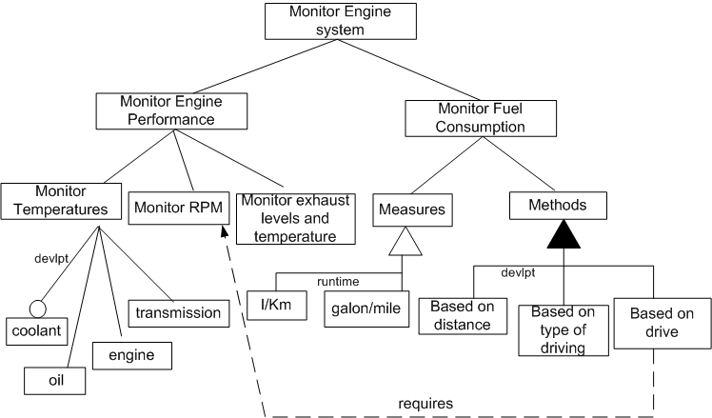
FD dialects
FODA (OFT)
[Kang et al., 1990]
FeatuRSEB (RFD)
[Griss et al., 1998]
PLUSS (PFT)
[Eriksson et al., 2005]
FORM (OFD)
[Kang et al., 1998]
Gen. Prog. (GPFT)
[Czarnecki et al.,
2000]
EFD
[Riebisch et al., 2002]
VBFD
[van Gurp et al.,
2001]

Slide 56
FD dialects
FODA (OFT)
[Kang et al., 1990]
FeatuRSEB (RFD)
[Griss et al., 1998]
PLUSS (PFT)
[Eriksson et al., 2005]
Aesthetic
differences
FORM (OFD)
[Kang et al., 1998]
Gen. Prog. (GPFT)
[Czarnecki et al.,
2000]
EFD
[Riebisch et al., 2002]
VBFD
[van Gurp et al.,
2001]

Slide 57
FD dialects
FODA (OFT)
[Kang et al., 1990]
FeatuRSEB (RFD)
[Griss et al., 1998]
PLUSS (PFT)
[Eriksson et al., 2005]
Aesthetic
differences
Stronger
claims
FORM (OFD)
[Kang et al., 1998]
Gen. Prog. (GPFT)
[Czarnecki et al.,
2000]
EFD
[Riebisch et al., 2002]
VBFD
[van Gurp et al.,
2001]

Slide 58
FD dialects
FODA (OFT)
[Kang et al., 1990]
FeatuRSEB (RFD)
[Griss et al., 1998]
PLUSS (PFT)
[Eriksson et al., 2005]
Aesthetic
differences
Stronger
claims
Vague use of terms
syntax, semantics,
expressiveness, ambiguity,...
FORM (OFD)
[Kang et al., 1998]
Gen. Prog. (GPFT)
[Czarnecki et al.,
2000]
EFD
[Riebisch et al., 2002]
VBFD
[van Gurp et al.,
2001]

Slide 59
Concrete (graphical) syntax matters…
But semantics even more!

Slide 60
Feature Models
~ Feature Diagrams
(suggest a visual representation) but that’s not mandatory that does not necessary scale or respond to users’ concerns

Slide 64
Visualisation will help, right ?
Tools create their own problems
Lock-in, dependance
Some information is inevitably textual
  OCL constraints in UML
  Minispecs in StateCharts
  Attributes and constraints in FD

Slide 65
Why not use text altogether ?
There are powerful tools for that
Helps with
  Editing
  Transformation
  Versioning
  Information exchange
  …
Graphical views can be generated anyway

Slide 66
Not a new idea
Language | User Friendly | Attributes | Cardinalities | Cross tree constraints | Modula-risation
Van Deursen et al. | ✔
GUIDSL (AHEAD) | ✔
SXFM | ✔
XML-based (FAMA etc.) |  | ✔ | ✔ | ✔
+ CML
+ VSL

Slide 67
Furthermore
Intuitive C-like syntax
Formal semantics
Statically typed
Editing facilities
  Textual editor with auto-completion

Slide 68
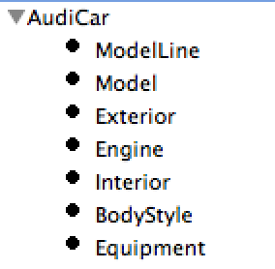



TVL : allOf – and decomposition
root AudiCar { group allOf { ModelLine, BodyStyle,
Model, Engine, Exterior, Interior, Equipment
}
}
root feature
and decomposition
all subfeatures must be present in the product
sub features

Slide 69
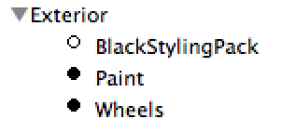
TVL : optional features
all subfeatures
must be present in the product
Exterior{
group allof {
Wheels,
Paint,
opt BlackStylingPack
}
}
except this one
it is optional

Slide 70
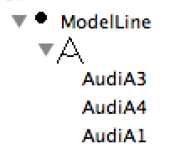
TVL : one of – xor decomposition
feature definition
xor decomposition
one and only one subfeature must be present in the product
ModelLine {
group oneof {
AudiA1 {
AudiA1 -> (A1 || A1Sportback);
AudiA1 -> (Door3 || Sportback);
},
AudiA3
{
AudiA3 -> (A3 || A3Sportback || A3Cabriolet
|| S3 || S3Sportback || RS3Sportback);
AudiA3 -> (Door3 || Sportback || Cabriolet);
},
AudiA4
{
AudiA4 -> (A4Avant || A4AllroadQuattro || S4Avant);
AudiA4 -> (Avant || AllroadQuattro);
},
}
}
constraints definition
Boolean expressions in terms of features
that must remain true

Slide 71
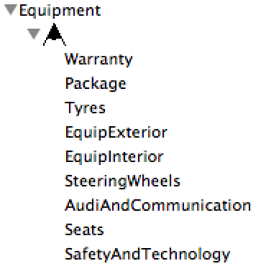
TVL : someOf – or decomposition
feature definition
or decomposition
Equipment{
group someof {
Package,
EquipExterior,
Tyres,
EquipInterior,
SteeringWheels,
Seats,
SafetyAndTechnology,
AudiAndCommunication,
Warranty
}
}
one or more subfeatures must be present in the product

Slide 72
TVL : Modularity
root Car {
group allOf {
BodyStyle,
Model,
Engine,
Equipment }
}
include(BodyStyle.tvl);
include(Model.tvl);
include(Engine.tvl);
include(Equipment.tvl);
Split model in reusable parts
using external files

Slide 73
TVL : Modularity
BodyStyle.tvl
Model.tvl
Engine.tvl
BodyStyle {
group oneof {
Avant,
Door3,
Sportback,
Coupe,
Cabriolet,
Roadster,
Spyder,
SUV
}
}
Model {
group oneof {
    A1,
    A3,
    S3,
    A4,
    S4,
    A5,
    S5,
    RS5,
    A6,
    A7,
    A8,
    A8L,
    R8
    Q3,
    Q5,
    Q7,
    TT,
    TTS,
    TT RS
}
}
Engine {
group oneof {
  SE12TFSI,
  CE14TFSI,
  CE14TFSI119,
  Sport12TFSI,
  Sport14TFSI,
  Sport14TFSI119,
  BlackEdition14TFSI,
  SLine12TFSI,
  SLine14TFSI,
  SE16TDI,
  CE16TDI,
  CE20TDI,
  ...
}
}

Slide 74
TVL : Tools
Key references
  Classen, A.; Boucher, Q. and Heymans, P. A Text-based Approach to Feature Modelling: Syntax and Semantics of TVL. In Science of Computer Programming (SCP), Special Issue on Software Evolution
  Hubaux, A.; Boucher, Q.; Hartman, H.; Michel, R. and Heymans, P. Evaluating a Text-based Feature Modelling Language: Four Industrial Case (SLE 2010)
  http://info.fundp.ac.be/tvl/
Support
  Parser / Syntactic and semantic checker
  SAT-based checker for Boolean models
Lessons learned
  Textual vs graphical languages
  Semantics of your language matter

Slide 75
I want to analyze and play with my specification!

Slide 76

Empty set of configurations

Slide 77
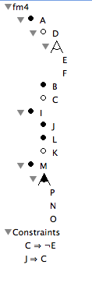
Dead feature
False optional feature

Slide 78
Core features
{CarEquipment, Comfort, DrivingAndSafety, Healthing}

Slide 79
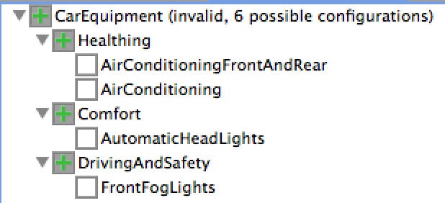
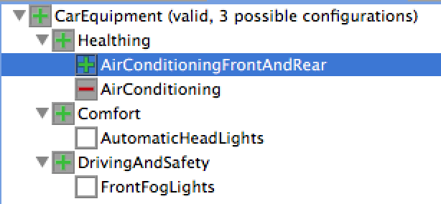
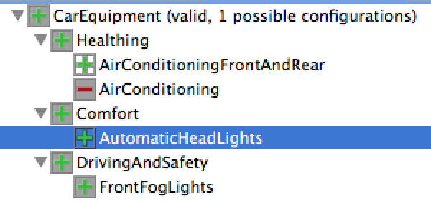
Interactive Configuration

Slide 80
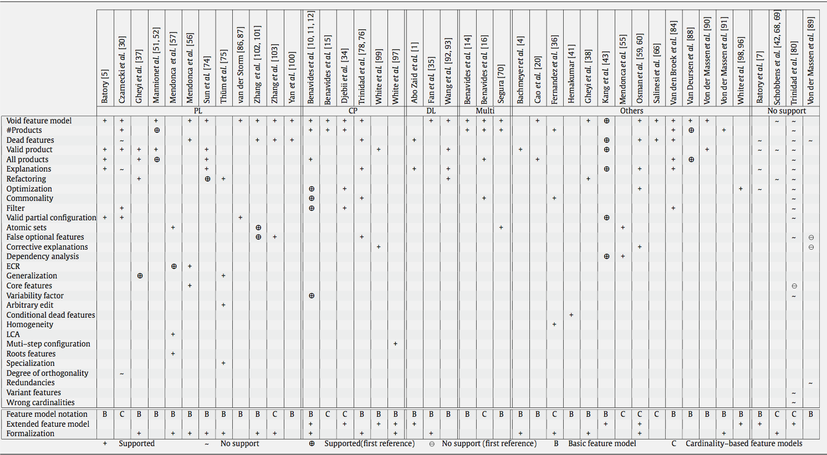
Feature Models and Automated Reasoning
Benavides et al. survey, 2010

Slide 81
Decision problems and complexity
Validity of a feature model
Validity of a configuration
Computation of dead and core features
Counting of the number of valid configurations
Equivalence between two feature models
Satisfiability (SAT) problem
  NP-complete

Slide 82
How to automate analysis of your feature models?
Binary Decision Diagram (BDD)
SAT solver

Slide 83
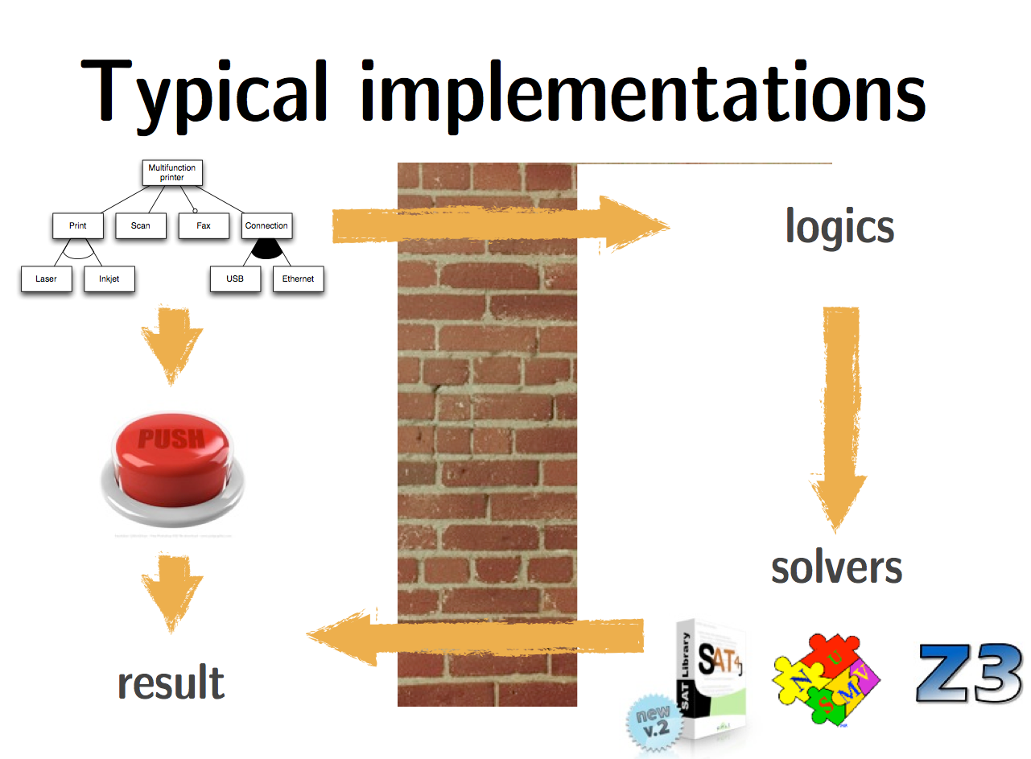

Slide 84
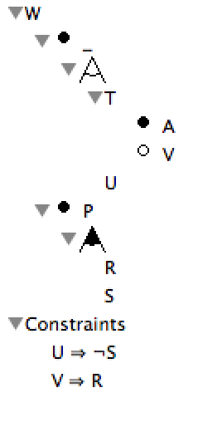
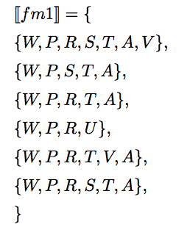
(Boolean) Feature Models
Hierarchy + Variability = set of valid configurations
fm1
Notes:
To implement all these reasoning operations, we need scalable techniques as the number of valid configurations may be exponential to the number of features.
State of the art solutions consist in encoding the feature model as a propositional formula.
State-of-the-art Support pour travailler
A feature model is a hierarchy of features with variabilty
The primary purpose of the hierarchy is to organize features into multiple levels of increasing detail
Variability deﬁnes what the allowed combinations of features are.
Variability in a feature model is expressed through different mechanisms.
describes a set of valid feature combinations.

Slide 85
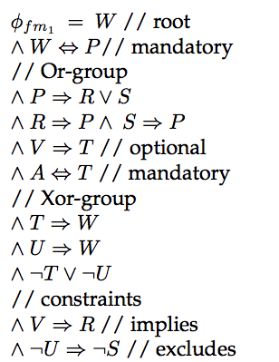
(Boolean) Feature Models
~ Boolean formula
fm1
Notes:
To implement all these reasoning operations, we need scalable techniques as the number of valid configurations may be exponential to the number of features.
State of the art solutions consist in encoding the feature model as a propositional formula.
State-of-the-art Support pour travailler
A feature model is a hierarchy of features with variabilty
The primary purpose of the hierarchy is to organize features into multiple levels of increasing detail
Variability deﬁnes what the allowed combinations of features are.
Variability in a feature model is expressed through different mechanisms.
describes a set of valid feature combinations.

Slide 86
Truth table, boolean function
from |  | to
x₁ | x₂ | x₃ | x₄ | f
0 | 0 | 0 | 0 | 0
0 | 0 | 0 | 1 | 1
0 | 0 | 1 | 0 | 1
0 | 0 | 1 | 1 | 1
0 | 1 | 0 | 0 | 0
0 | 1 | 0 | 1 | 0
0 | 1 | 1 | 0 | 0
0 | 1 | 1 | 1 | 1
1 | 0 | 0 | 0 | 0
1 | 0 | 0 | 1 | 0
1 | 0 | 1 | 0 | 0
1 | 0 | 1 | 1 | 1
1 | 1 | 0 | 0 | 0
1 | 1 | 0 | 1 | 0
1 | 1 | 1 | 0 | 0
1 | 1 | 1 | 1 | 0
Notes:
We can represent this relation as a binary function. We first label each node in the call graph with a binary number ©, so A is 00, B is 01, C is 10, and D is 11. We then use a function that equals one if the call graph edge exists, and zero if the edge doesn’t exist. Here is the truth table for the function that corresponds to the call graph relation. There are five ones corresponding to the five call graph edges, and the rest are zeroes.

Slide 87
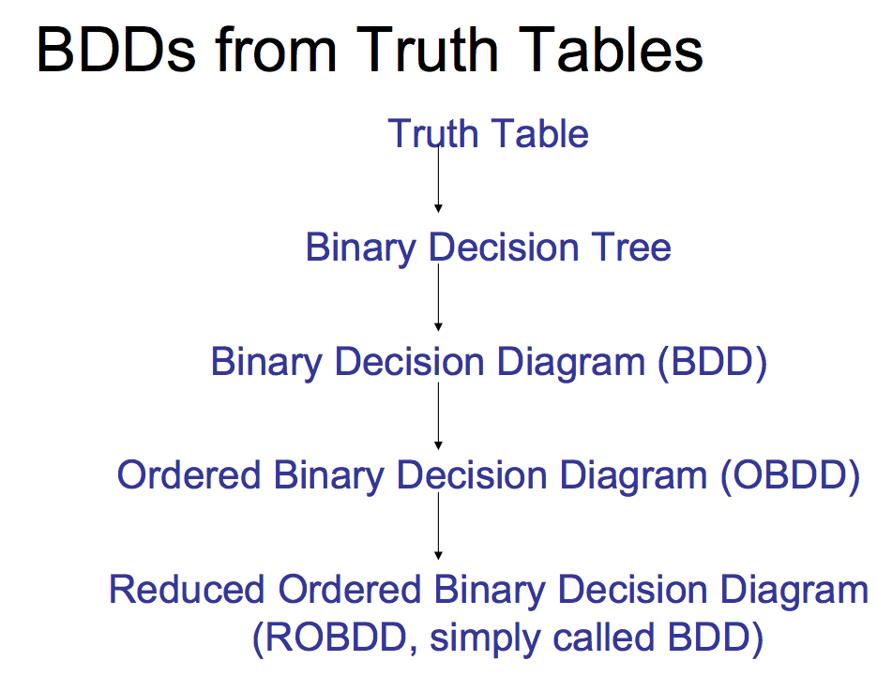
Notes:
Binary decision diagrams are just a graphical encoding of a boolean function. Each node in the BDD is labeled with a variable. There are two kinds of edges, 0 edges and 1 edges. If the value of the variable at the node is zero, we follow the dotted zero edge, and if the value of the variable is one, we follow the solid one edge. We just copy the last column of the truth table into the bottom of the diagram, so again we have the five ones that correspond to our five call graph edges, and the rest are zero. These square nodes along the bottom are called “terminal nodes”, because they have no outgoing edges.

Slide 88
Binary Decision Diagrams (Bryant 1986)
encoding of a truth table.
from |  | to
x₁ | x₂ | x₃ | x₄ | f
0 | 0 | 0 | 0 | 0
0 | 0 | 0 | 1 | 1
0 | 0 | 1 | 0 | 1
0 | 0 | 1 | 1 | 1
0 | 1 | 0 | 0 | 0
0 | 1 | 0 | 1 | 0
0 | 1 | 1 | 0 | 0
0 | 1 | 1 | 1 | 1
1 | 0 | 0 | 0 | 0
1 | 0 | 0 | 1 | 0
1 | 0 | 1 | 0 | 0
1 | 0 | 1 | 1 | 1
1 | 1 | 0 | 0 | 0
1 | 1 | 0 | 1 | 0
1 | 1 | 1 | 0 | 0
1 | 1 | 1 | 1 | 0
x₁
0 edge
1 edge
x₂
x₂
x₃
x₃
x₃
x₃
x₄
x₄
x₄
x₄
x₄
x₄
x₄
x₄
0
1
1
1
0
0
0
1
0
0
0
1
0
0
0
0
Notes:
Binary decision diagrams are just a graphical encoding of a boolean function. Each node in the BDD is labeled with a variable. There are two kinds of edges, 0 edges and 1 edges. If the value of the variable at the node is zero, we follow the dotted zero edge, and if the value of the variable is one, we follow the solid one edge. We just copy the last column of the truth table into the bottom of the diagram, so again we have the five ones that correspond to our five call graph edges, and the rest are zero. These square nodes along the bottom are called “terminal nodes”, because they have no outgoing edges.

Slide 89
Reduction
Identify Redundancies
3 Rules
  Merge equivalent leaves
  Merge isomorphic nodes
  Eliminate redundant tests

Slide 90

  Merge equivalent leaves

Slide 91

  Merge isomorphic nodes

Slide 92

  Eliminate redundant tests

Slide 93
Binary Decision Diagrams
Collapse redundant nodes.
x₁
0 edge
1 edge
x₂
x₂
x₃
x₃
x₃
x₃
x₄
x₄
x₄
x₄
x₄
x₄
x₄
x₄
0
1
1
1
0
0
0
1
0
0
0
1
0
0
0
0
Notes:
Notice that there is a lot of redundancy in this diagram. Specifically, any node that has the same label and the same successors is redundant, and can be collapsed. So we can collapse all of the zero nodes and likewise all of the one nodes, like this.

Slide 94
Binary Decision Diagrams
Collapse redundant nodes.
x₁
0 edge
1 edge
x₂
x₂
x₃
x₃
x₃
x₃
x₄
x₄
x₄
x₄
x₄
x₄
x₄
x₄
0
1
Notes:
Now we can collapse some of the x4 nodes, like this.

Slide 95
Binary Decision Diagrams
Collapse redundant nodes.
x₁
0 edge
1 edge
x₂
x₂
x₃
x₃
x₃
x₃
x₄
x₄
x₄
0
1
Notes:
Also two of the x3 nodes, like this.

Slide 96
Binary Decision Diagrams
Collapse redundant nodes.
x₁
0 edge
1 edge
x₂
x₂
x₃
x₃
x₃
x₄
x₄
x₄
0
1
Notes:
Now we have a smaller diagram. Also, any node that has the same successor for both its zero edge and its one edge can be eliminated.

Slide 97
Binary Decision Diagrams
Eliminate unnecessary nodes.
x₁
0 edge
1 edge
x₂
x₂
x₃
x₃
x₃
x₄
x₄
x₄
0
1
Notes:
So these three nodes can be eliminated because they have the same zero and one edge successors.

Slide 98
Binary Decision Diagrams
Eliminate unnecessary nodes.
x₁
0 edge
1 edge
x₂
x₂
x₃
x₃
x₄
0
1
Notes:
Finally, we get this diagram, which is the reduced BDD for this function.

Slide 99
Binary Decision Diagrams (BDDs)
Very efficient structure for most of the satisfiability operations
Polynomial in time for checking satisfiability and determining equivalence between two BDDs
Graph trasversal
So great?

Slide 100

Binary Decision Diagrams (BDDs):
Theoretical Problem
The size of the BDD is very sensitive to the order of the BDD variables
  e.g. two equivalent BDDs for the same feature model
[Mendonca, slide]

Slide 101
Binary Decision Diagrams (BDDs):
Theoretical Problem
The size of the BDD is very sensitive to the order of the BDD variables
  e.g. two equivalent BDDs for the same feature model
May lead to size explosion
[Mendonca, slide]

Slide 102
Binary Decision Diagrams (BDDs):
Theoretical Problem
The size of the BDD is very sensitive to the order of the BDD variables
  e.g. two equivalent BDDs for the same feature model
Best order: NP-complete!
[Mendonca, slide]

Slide 103
Binary Decision Diagrams (BDDs):
Practical Problem
The size of the BDD is very sensitive to the order of the BDD variables. In practice: BDDs cannot be build for feature models with 2000+ features
Heuristics needed
[Mendonca, slide]

Slide 104
How to automate analysis of your feature models?
Let us try with SAT solvers

Slide 105

Satisfiability (SAT) solver
A “SAT solver” is a program that automatically decides whether a propositional logic formula is satisfiable.
  If it is satisfiable, a SAT solver will produce an example of a truth assignment that satisfies the formula.
Basic idea: since all NP-complete problems are mutually reducible:
  Write one really good solver for NP-complete problems (in fact, get lots of people to do it. Hold competitions.)
  Translate your NP-complete problems to that problem.

Slide 106
SAT solver and CNF
All current fast SAT solvers work on CNF
Terminology:
  A literal is a propositional variable or its negation (e.g., p or ¬q).
  A clause is a disjunction of literals (e.g., (p ∨ ¬q ∨ r )). Since ∨ is associative, we can represent clauses as lists of literals.
A formula is in conjunctive normal form (CNF) if it is a conjunction of clauses
  e.g., (p ∨ q ∨ ¬r) ∧ (¬p ∨ s ∨ t ∨ ¬u)

Slide 107


SAT solver and Unit Propagation
Whenever all the literals in a clause are false except one, the remaining literal must be true in any satisfying assignment (such a clause is called a unit clause).
  Therefore, the algorithm can assign it to true immediately. After choosing a variable there are often many unit clauses.
  Setting a literal in a unit clause often creates other unit clauses, leading to a cascade.
A good SAT solver often spends 80-90% of its time in unit propagation.

Slide 108


Slide 109


Slide 110


Slide 111


Slide 112


Slide 113

SAT solver and Unit Propagation

Slide 114
How to automate analysis of your feature models?
Let us use BDDs and SAT solvers

Slide 115

Consistency
SAT-Solver
  SAT(FM)

Slide 116

Core and dead features
Dead : SAT(FM ^ F)
Core: SAT(FM ^ not(F))

Slide 117


Partial configuration
SAT(FM ^ PK ^ F)
SAT(FM ^ PK ^ not(F))

Slide 118

Relationship between feature models
Refactoring
  Tautology: (FM1 <=> FM2)
  = not SAT(not (FM1 <=> FM2))

Slide 119
How can I use automated analysis in practice?

Slide 120

Like this?

Slide 121

No. Like this!

Slide 122
FAMILIAR: domain-specific language
more concise and readable
no need to learn a (set of) API
interoperability facilities

Slide 123
See FAMILIAR

Slide 124
Recap and Conclusion

Slide 125
Feature model in the SPL framework
Not restricted to document/communicate
  Product/model derivation
    reminder of previous course
Safe composition and automated reasoning
Generation of Configurators

Slide 126
Feature Models
+ other artefacs
(what we can do with feature models)

Slide 127
“features” in feature models: a label

Slide 128


Slide 129


Slide 130

Ooops

Slide 131
Safe composition? No!

Slide 132

Safe composition: how does it work?
Another propositional formula

Slide 133

Mapping: an example
class Graph {
Vector nv = new Vector(); Vector ev = new Vector();
Edge add(Node n, Node m) {
Edge e = new Edge(n, m);
nv.add(n); nv.add(m); ev.add(e);
e.weight = new Weight();
return e;
}
Edge add(Node n, Node m, Weight w)
Edge e = new Edge(n, m);
nv.add(n); nv.add(m); ev.add(e);
e.weight = w; return e;
}
void print() {
for(int i = 0; i < ev.size(); i++) {
((Edge)ev.get(i)).print();
}
}
}
class Graph {
Vector nv = new Vector(); Vector ev = new Vector();
Edge add(Node n, Node m) {
Edge e = new Edge(n, m);
nv.add(n); nv.add(m); ev.add(e);
e.weight = new Weight();
return e;
}
Edge add(Node n, Node m, Weight w)
Edge e = new Edge(n, m);
nv.add(n); nv.add(m); ev.add(e);
e.weight = w; return e;
}
void print() {
for(int i = 0; i < ev.size(); i++) {
((Edge)ev.get(i)).print();
}
}
}
class Node {
int id = 0;
Color color = new Color();
void print() {
Color.setDisplayColor(color);
System.out.print(id);
}
}
class Node {
int id = 0;
Color color = new Color();
void print() {
Color.setDisplayColor(color);
System.out.print(id);
}
}
class Edge {
Node a, b;
Color color = new Color();
Weight weight = new Weight();
Edge(Node _a, Node _b) { a = _a; b = _b; }
void print() {
Color.setDisplayColor(color);
a.print(); b.print();
weight.print();
}
}
class Edge {
Node a, b;
Color color = new Color();
Weight weight = new Weight();
Edge(Node _a, Node _b) { a = _a; b = _b; }
void print() {
Color.setDisplayColor(color);
a.print(); b.print();
weight.print();
}
}
class Edge {
Node a, b;
Color color = new Color();
Weight weight;
Edge(Node _a, Node _b) { a = _a; b = _b; }
void print() {
Color.setDisplayColor(color);
a.print(); b.print();
weight.print();
}
}
class Color {
static void setDisplayColor(Color c) { ... }
}
class Weight { void print() { ... } }

Slide 134



Slide 135


Slide 136
Summary
Variability models for mastering complexity: variability is everywhere, precise specification, automated reasoning and management
Feature Models
  Formalism and theory: modeling principles, semantics, logics
  Language to elaborate/build variability models
  Reasoning techniques to analyze properties of an SPL (scalable and automated way)
  Applications: variability models and so what?

Slide 137
reasoning and management
Textual or Graphical
Languages
Feature Model
Reusable Assets
(e.g., models or source code)
mapping
generation
derivation
Configurators
product_{n}

