Slide 1
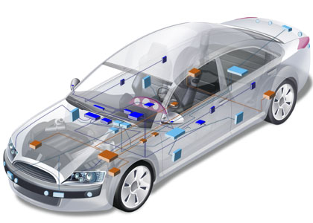

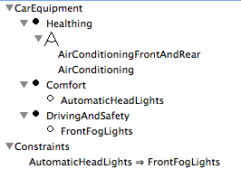

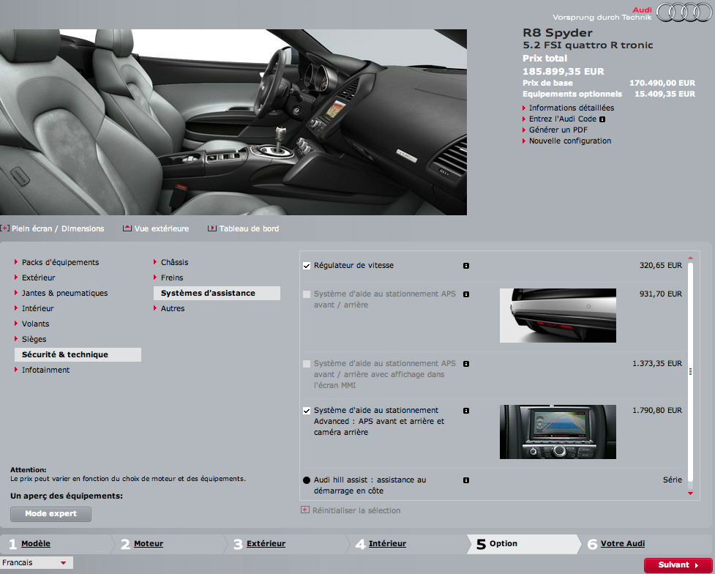




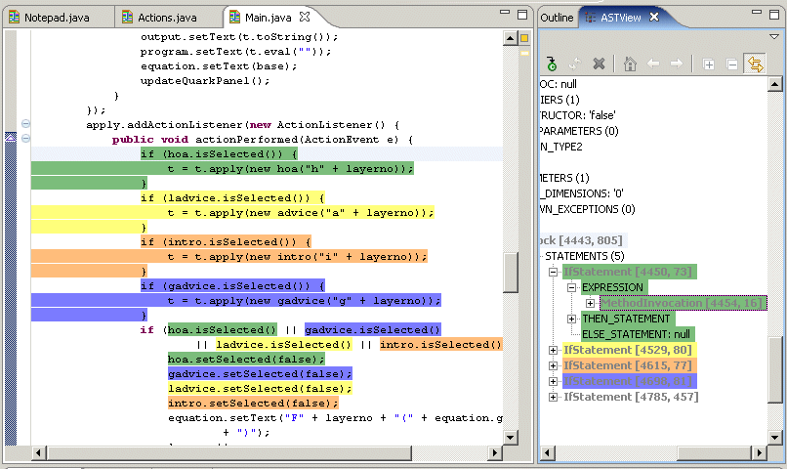




Managing Feature Models
Mathieu Acher

Slide 2
Learning
Feature Models with
(a.k.a implementing the introductory example)

Slide 3

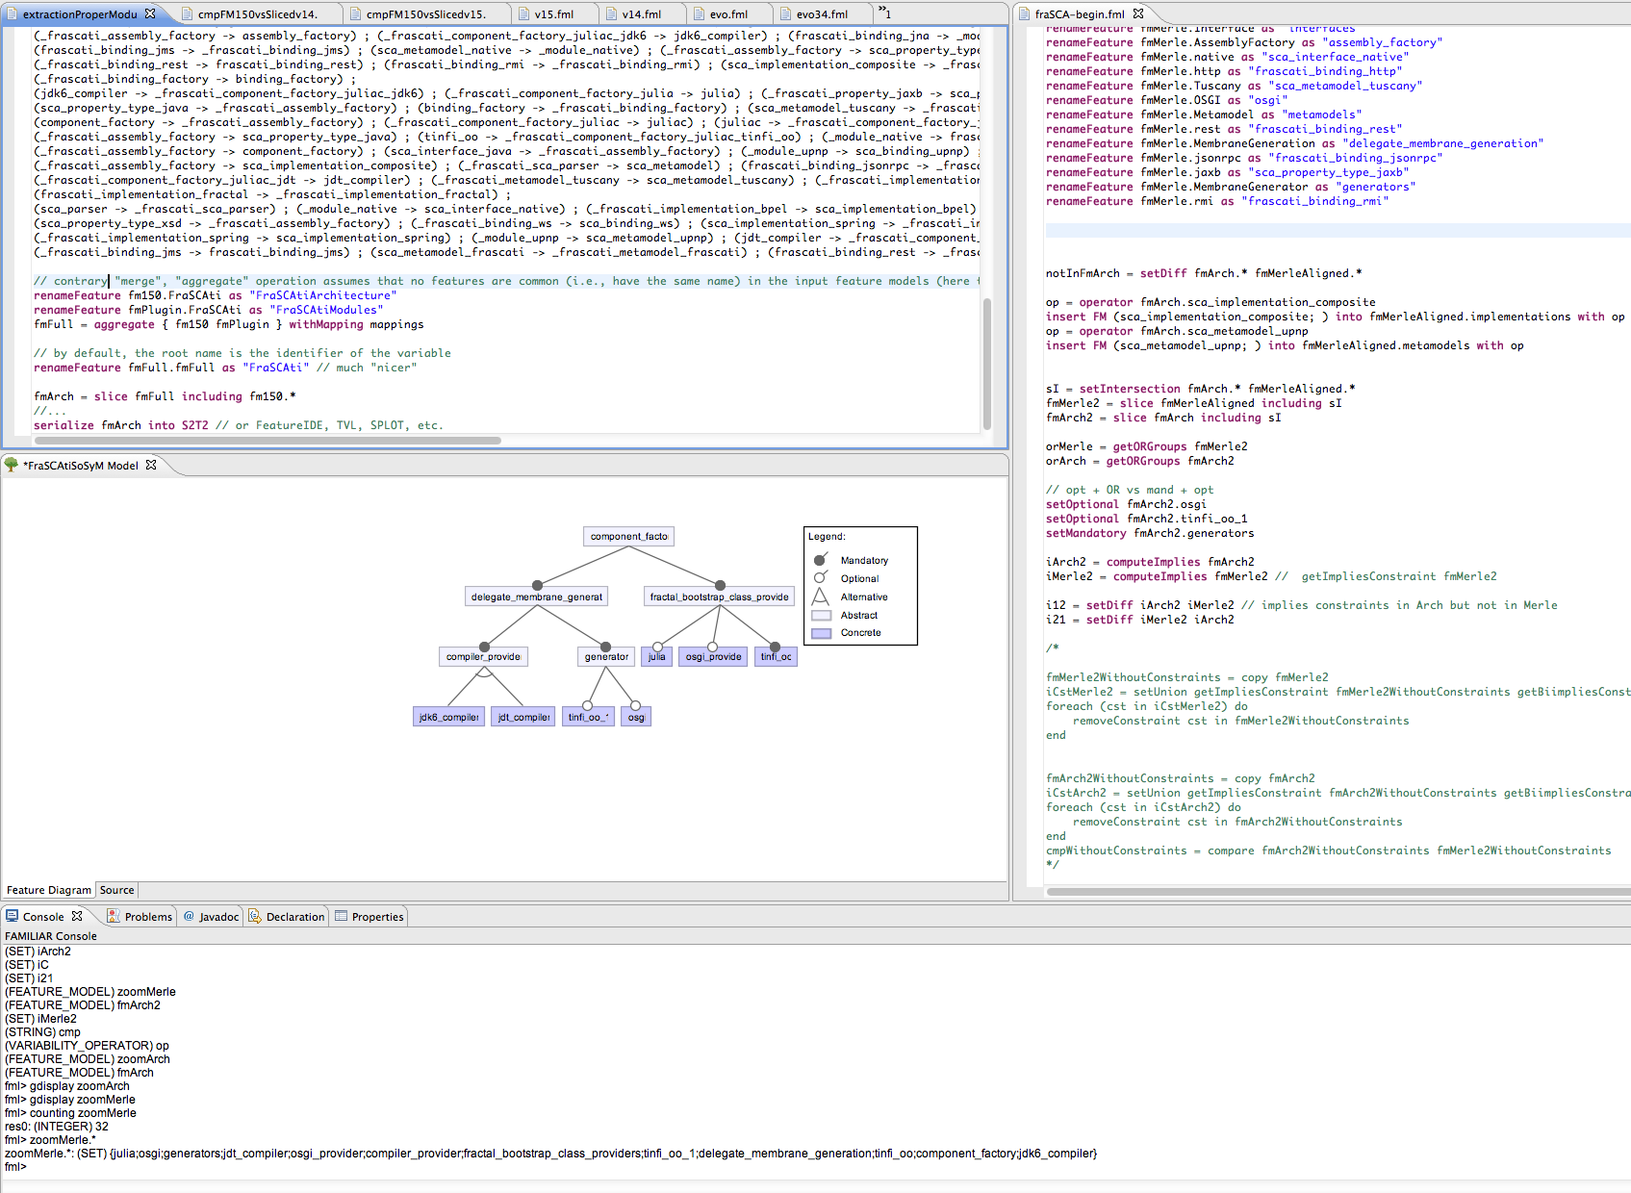


(FeAture Model scrIpt Language for manIpulation and Automatic Reasoning)
http://familiar-project.github.com/
φ
TVL
DIMACS
Mathieu Acher, Philippe Collet, Philippe Lahire, Robert B. France « A Domain-Specific Language for Large-Scale Management of Feature Models » Science of Computer Programming (SCP), 2013

Slide 4
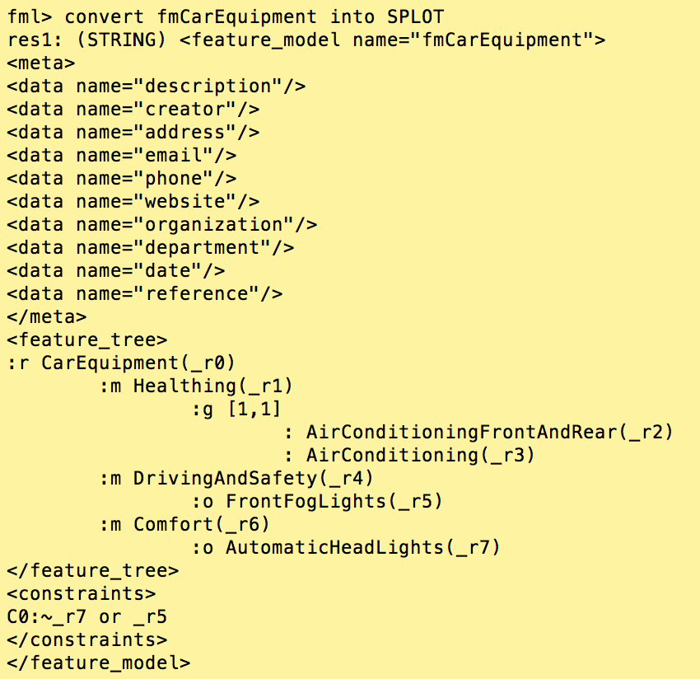
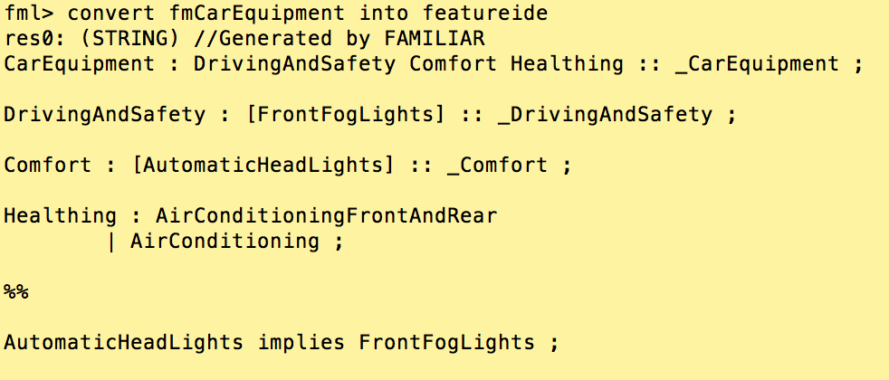
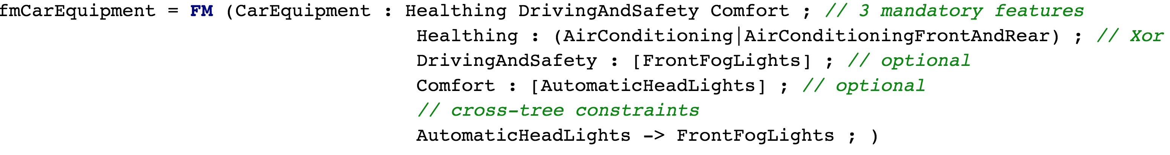
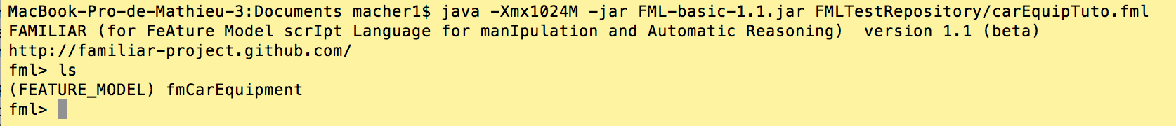

Slide 5
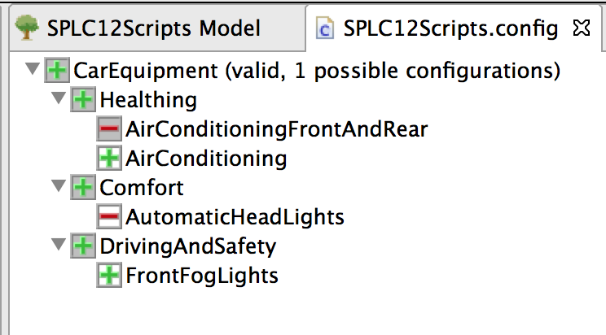
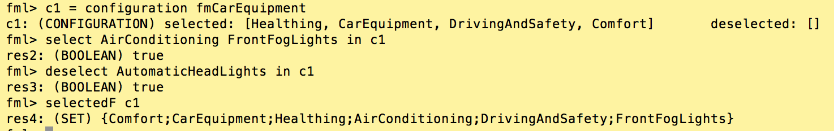

Slide 6
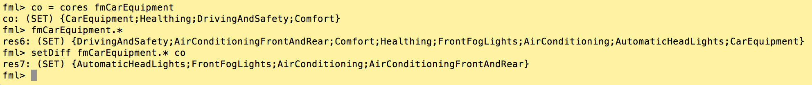
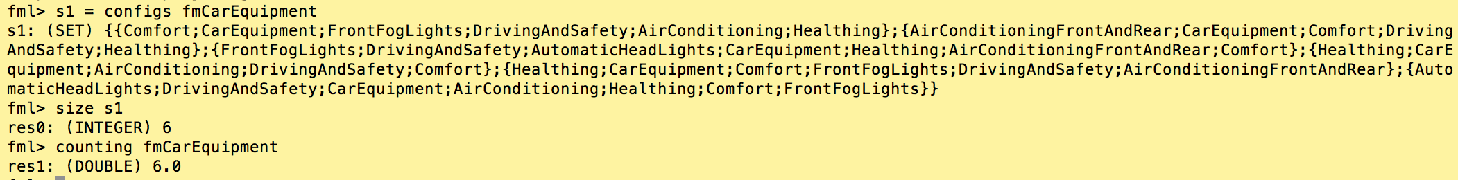
{CarEquipment, Comfort, DrivingAndSafety, Healthing}
{AirConditioning, FrontFogLights}
{AutomaticHeadLights, AirConditioning, FrontFogLights}
{AutomaticHeadLights, FrontFogLights, AirConditioningFrontAndRear}
{AirConditioningFrontAndRear}
{AirConditioning}
{AirConditioningFrontAndRear, FrontFogLights}
X

Slide 7
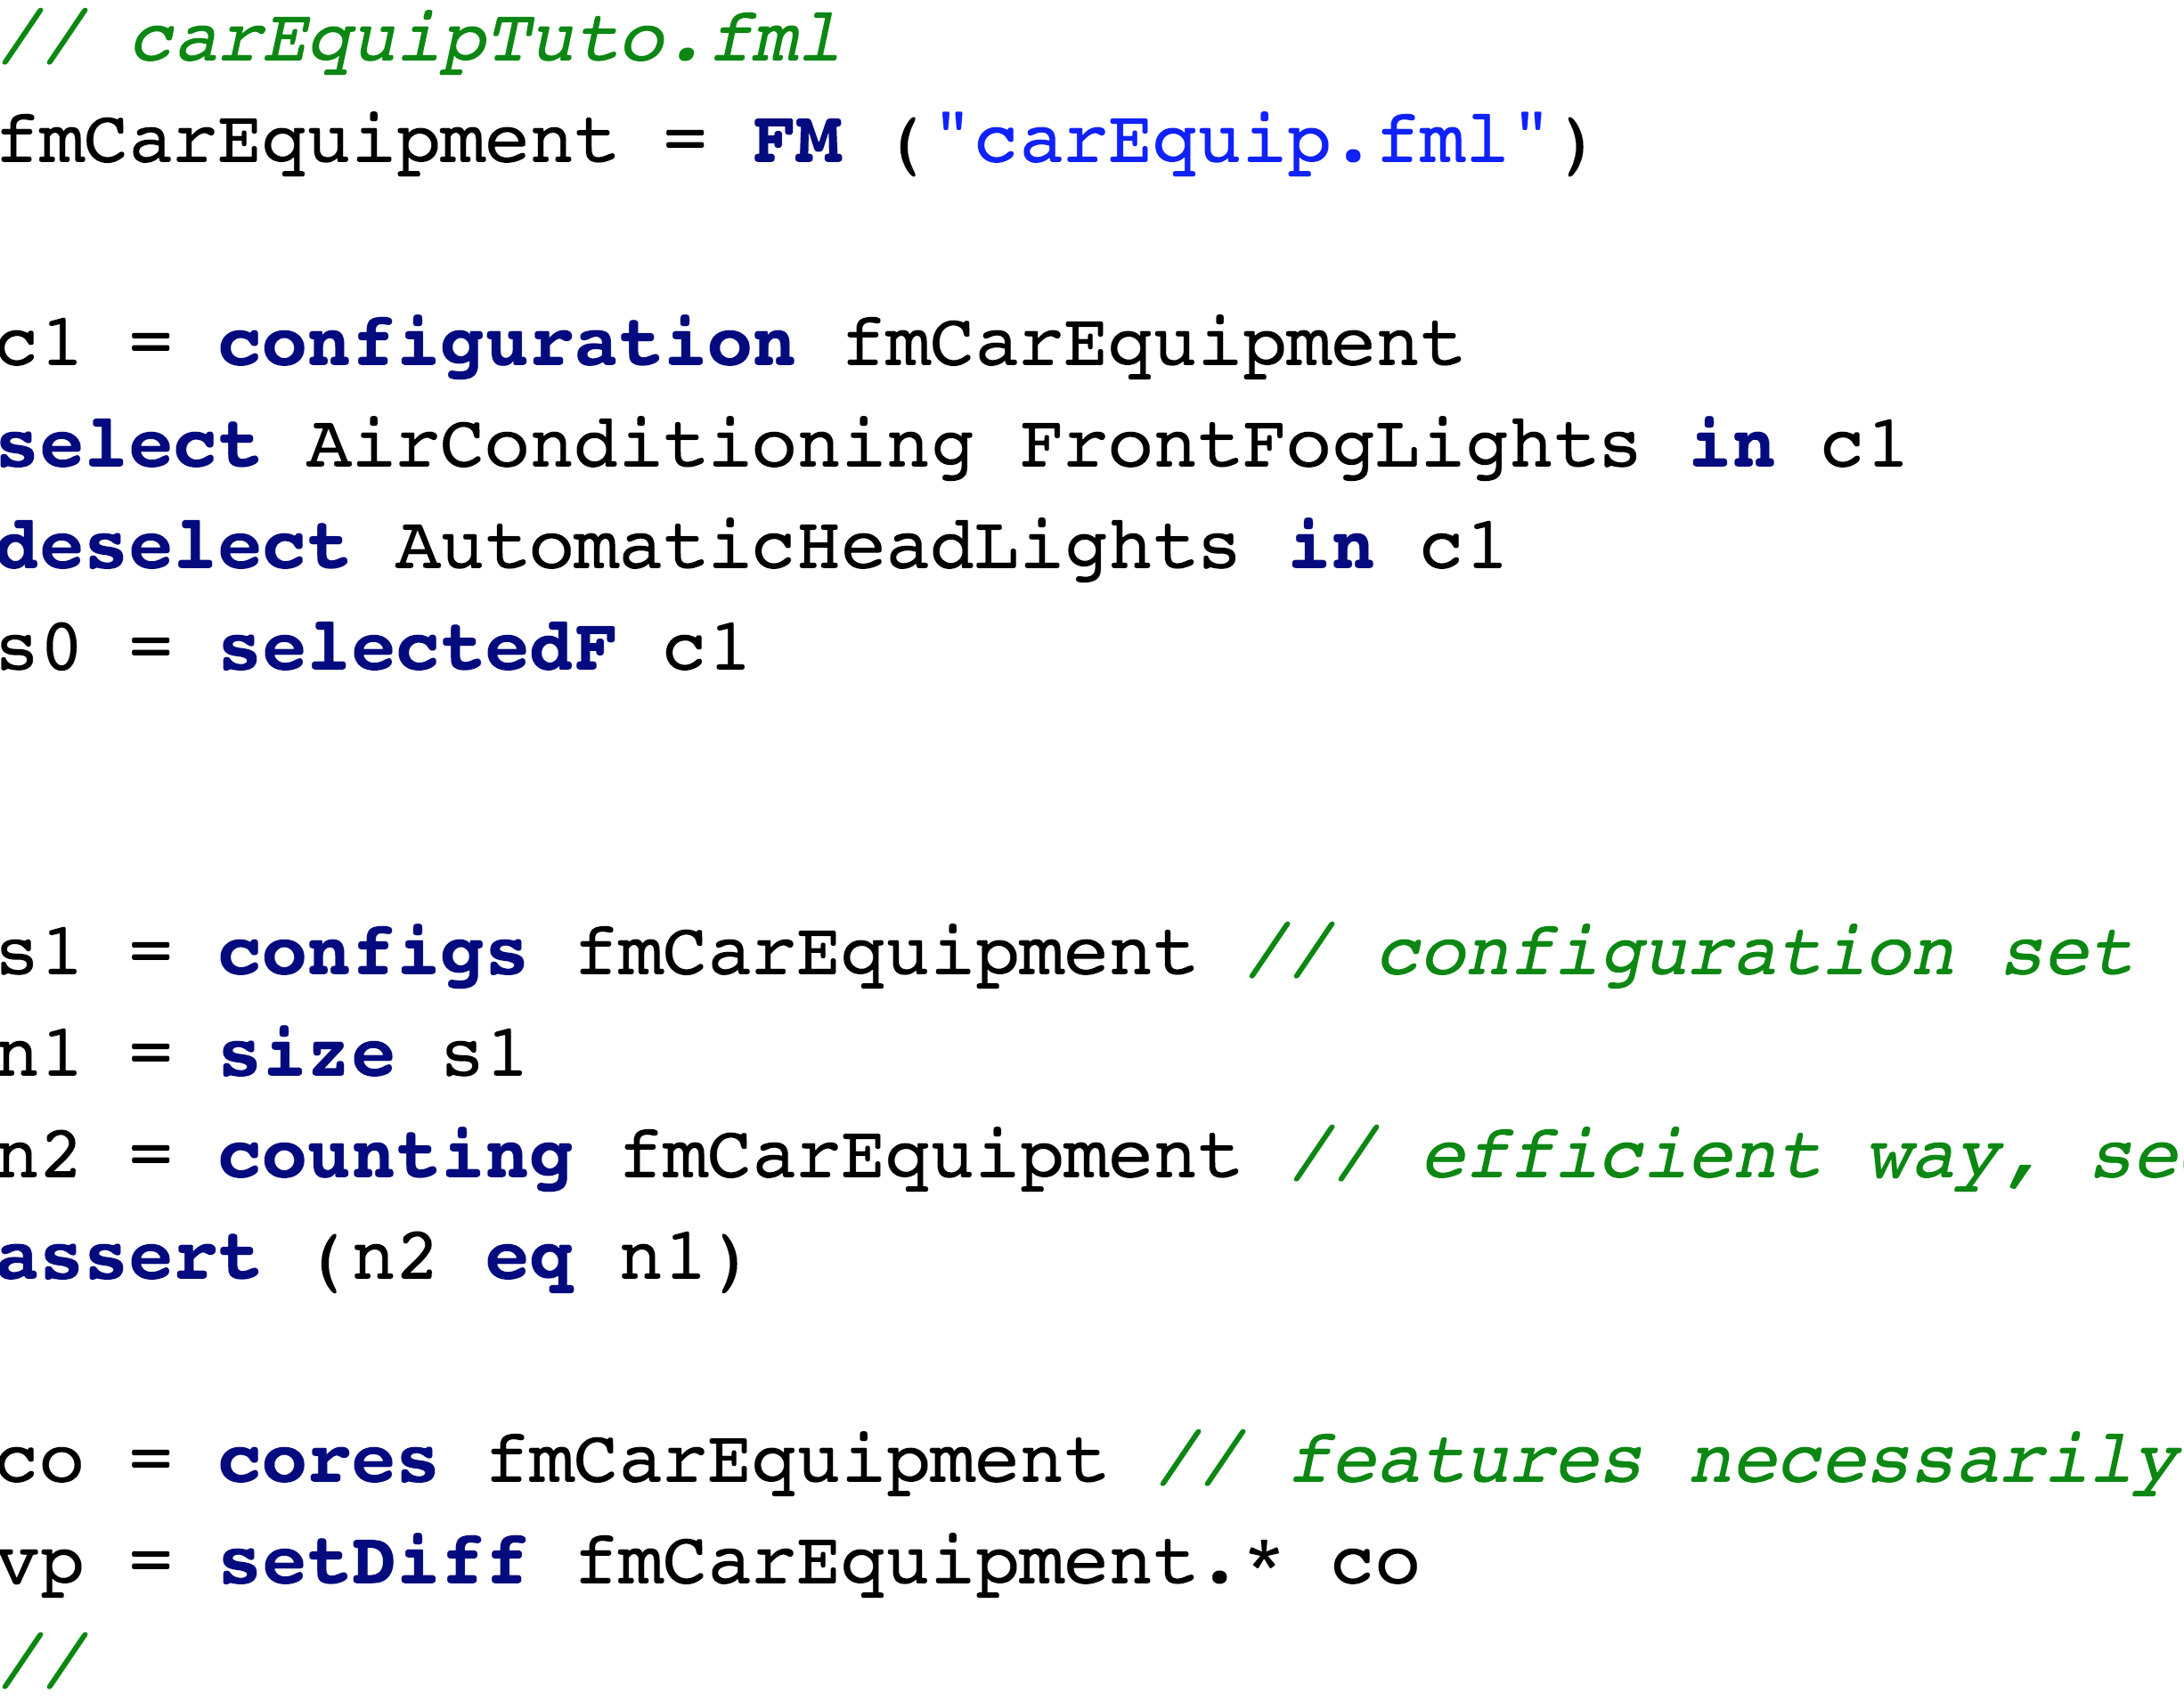

Slide 8
Much more than that!
Let us have a deeper look

Slide 9
(FeAture Model scrIpt Language for manIpulation and Automatic Reasoning)
http://familiar-project.github.com/
φ
TVL
DIMACS
importing, exporting, composing, decomposing, editing, configuring, reverse engineering, computing "diffs", refactoring, testing,
and reasoning about (multiple) variability models
Mathieu Acher, Philippe Collet, Philippe Lahire, Robert B. France « A Domain-Specific Language for Large-Scale Management of Feature Models » Science of Computer Programming (SCP), 2013

Slide 10
#1 Automated Analysis
Notes:
Or-group
An excerpt of the medical imaging analysis domain…… (justify)
Ref sur les feature models
A feature model is a hierarchy of features with variabilty
The primary purpose of the hierarchy is to organize features into multiple levels of increasing detail
Variability deﬁnes what the allowed combinations of features are.
Variability in a feature model is expressed through different mechanisms.
describes a set of valid feature combinations.

Slide 11
#2 Multiple Feature Models
Notes:
Or-group
An excerpt of the medical imaging analysis domain…… (justify)
Ref sur les feature models
A feature model is a hierarchy of features with variabilty
The primary purpose of the hierarchy is to organize features into multiple levels of increasing detail
Variability deﬁnes what the allowed combinations of features are.
Variability in a feature model is expressed through different mechanisms.
describes a set of valid feature combinations.

Slide 12

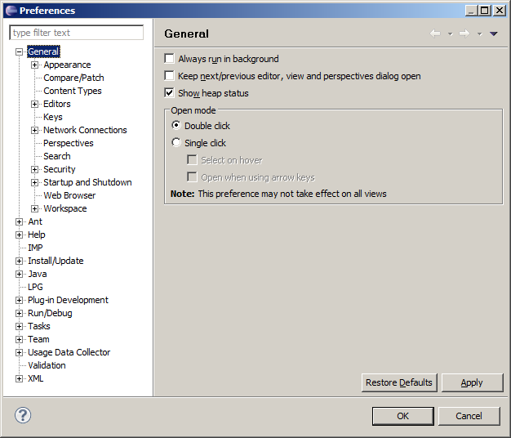
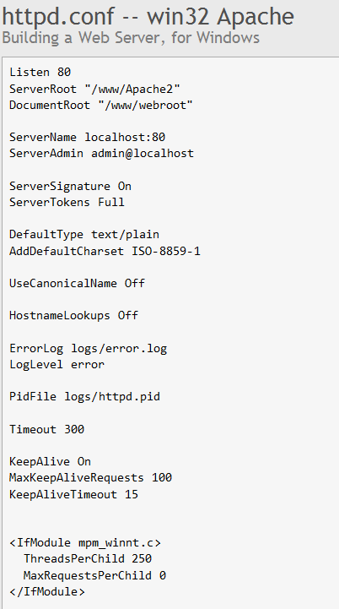

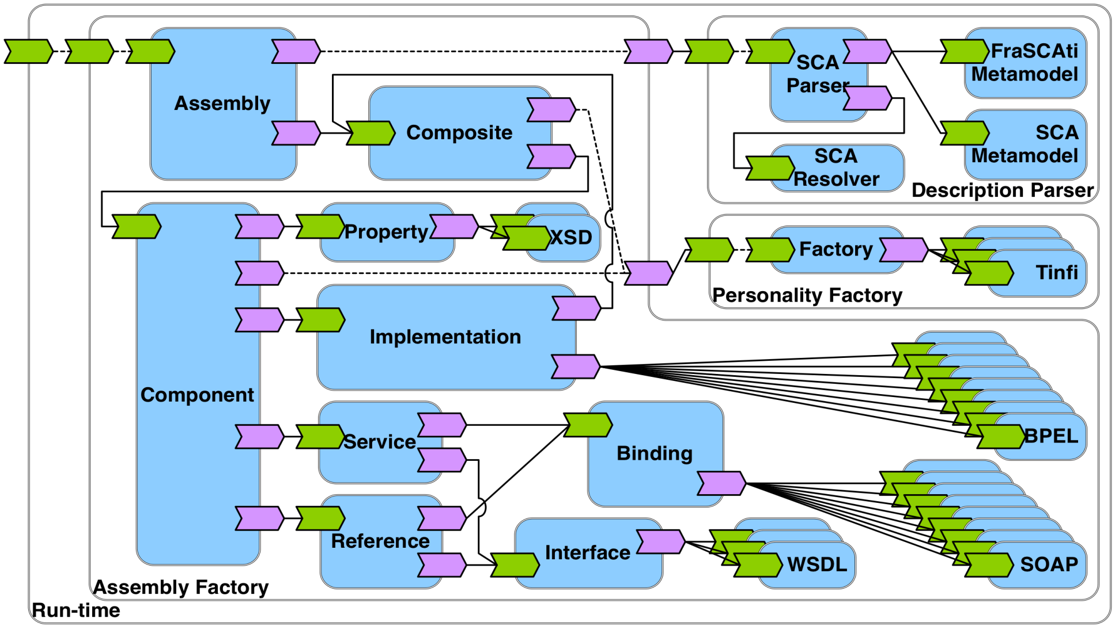
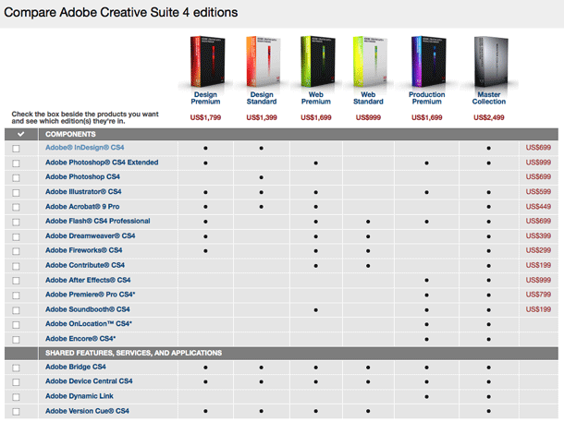
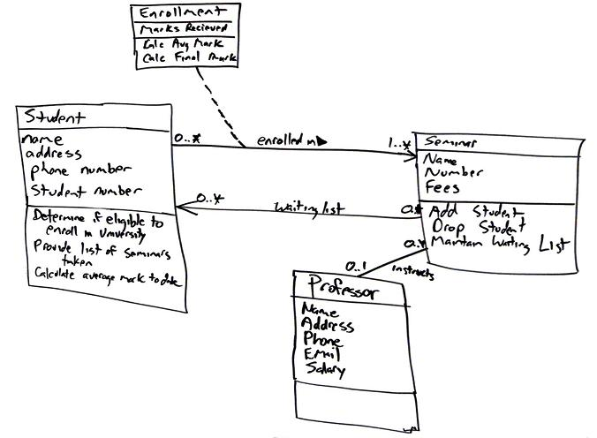
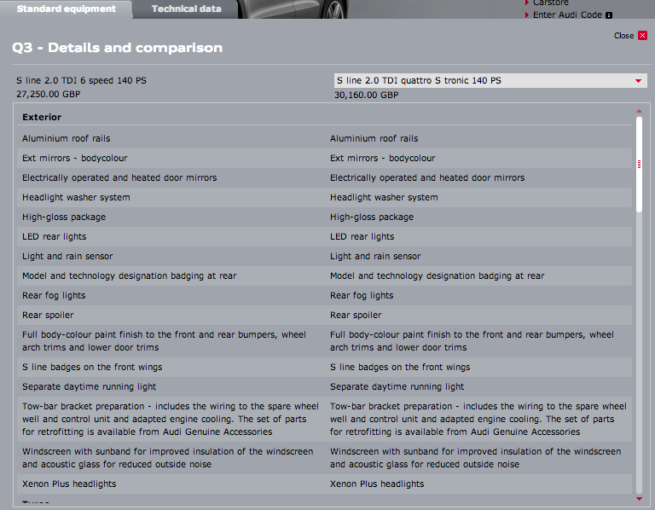
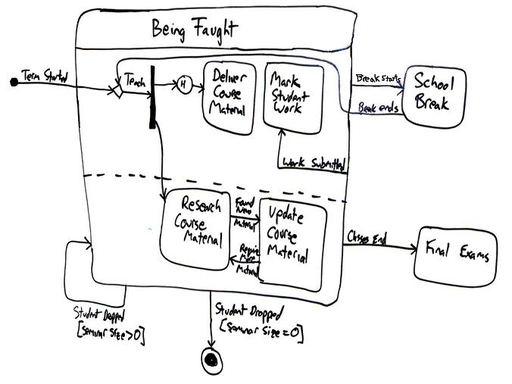
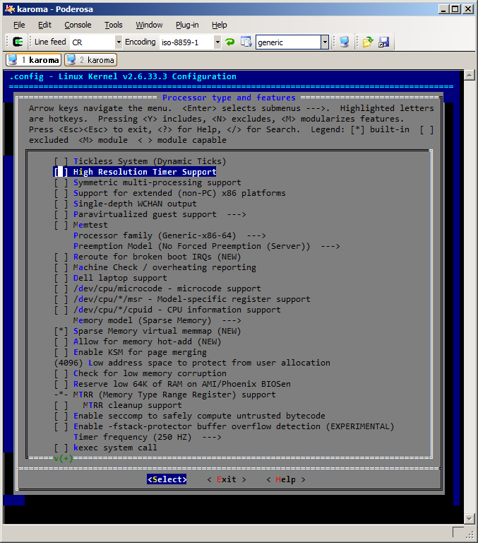
Multi-* variability
*systems, perspectives, or stakeholders
12

Slide 13
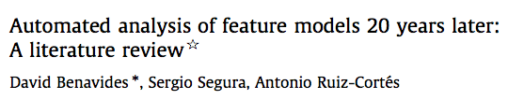
Two Key Requirements
#1 Automated analysis
  Aka support to better understand and play with your feature model (TVL model)
#2 Managing multiple feature models
  Composing / Decomposing / Diff and Reasoning about their relationships
  Combining these operators

Slide 14


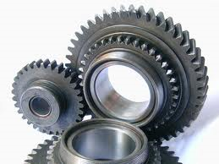

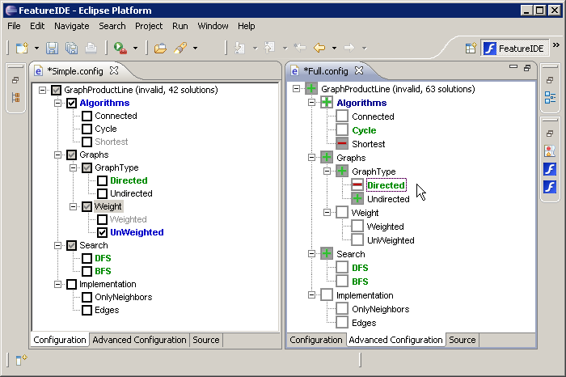
language and environment
// foo.fml
fm1 = FM (“foo1.tvl”)
fm2 = FM (“foo2.m”)
fm3 = merge intersection { fm1 fm2 }
c3 = counting fm3
renameFeature fm3.TV as “OutputTV”
fm5 = aggregate { fm3 FM (“foo4.xml”) }
assert (isValid fm5)
fm6 = slice fm5 including fm5.TV.*
export fm6
True/False
8759
“OutputTV”, “TV”
Interoperability
Language facilities
Environment

Slide 15
features
fm1 = FM(“foo.tvl”)
fm2 = FM (“foo.m”)
Interoperability
serialize fm4 into SPLOT
serialize fm1 into featureide
fm3 = FM (“foo.xmi”)
fm4 = FM (A : B ….)
configuration
select
deselect
asFM
counting
configs
cores
deads
isValid
Reasoning
falseOptionals
compare
cleanup
merge
diff
intersection
sunion
aggregate
map
unmap
extract slicing
De/Composition
insert
renameFeature
removeFeature
accessors
copy
setOptional
setMandatory
Editing
setAlternatives
setOr
modular mechanisms
restricted set of types
Language Facilities
fm1.*
fm1.B
iterator/conditional
assertion
Notes:
+BDD/SAT

Slide 16
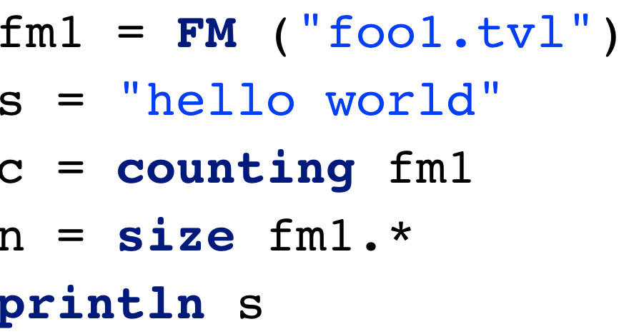

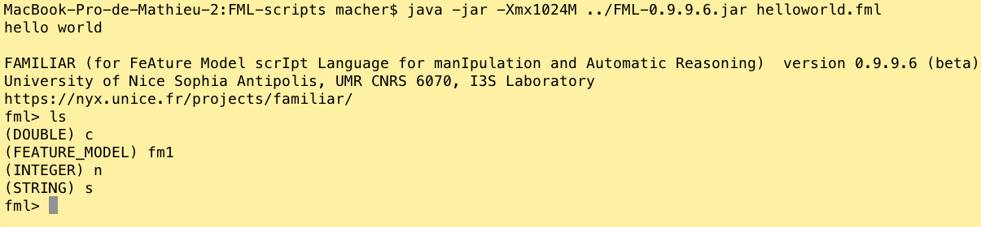
Hello World
helloworld.fml

Slide 17
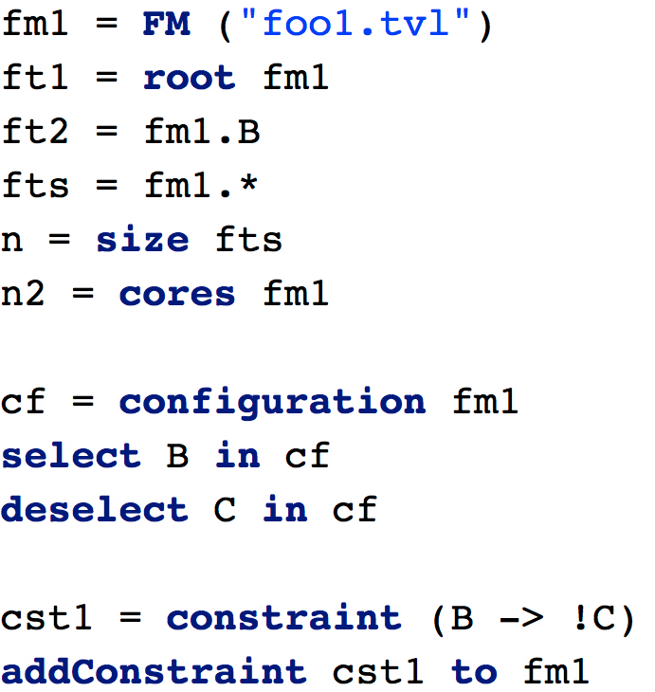
Typed language
basics2.fml
Domain-specific types
  Feature Model,
  Configuration,
  Feature,
  Constraint
Other types include
  Set
  String
  Boolean,
  Enum,
  Integer and Real.
A set of operations, called operators, are defined for a given type.

Slide 18
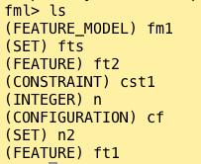
Typed language
basics2.fml

Slide 19
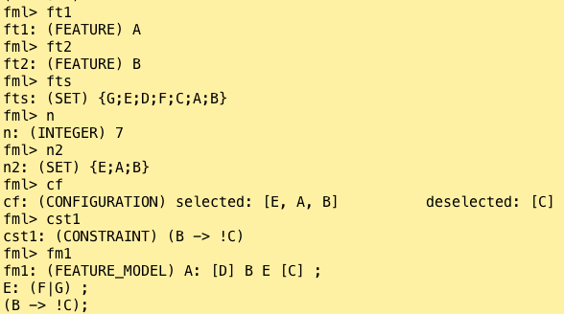
Typed language
basics2.fml

Slide 20
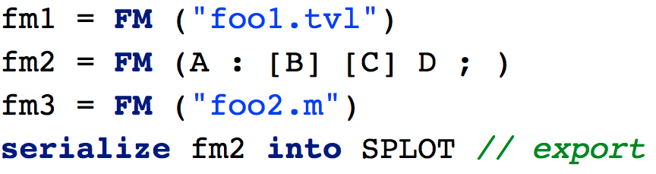
Importing/Exporting feature models
basics3.fml
Internal notation or by “filename extensions”

Slide 21

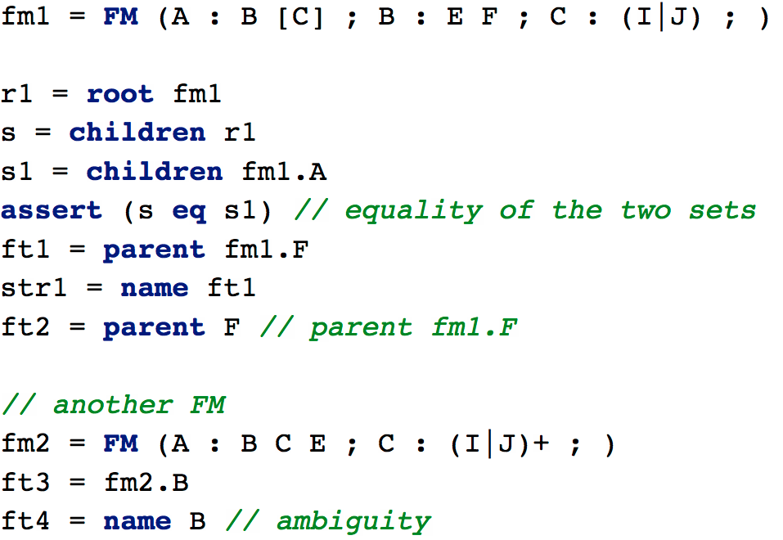

Feature Accessors (1)
ftAccessors.fml

Slide 22
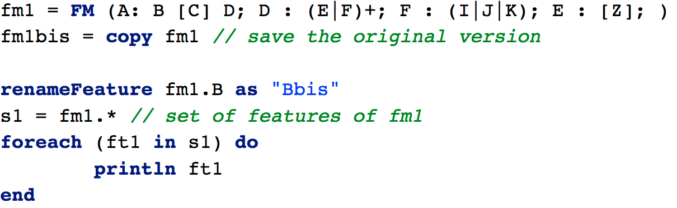
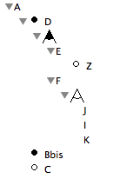
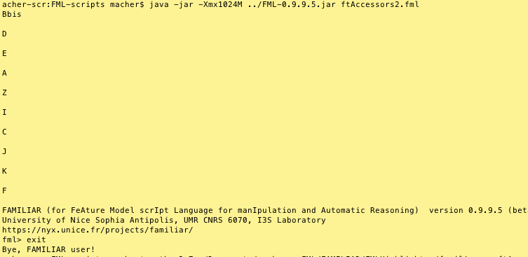
Other constructs
ftAccessors2.fml

Slide 23
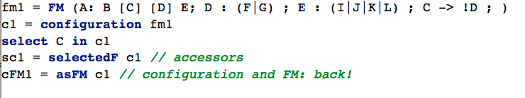
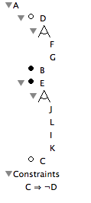
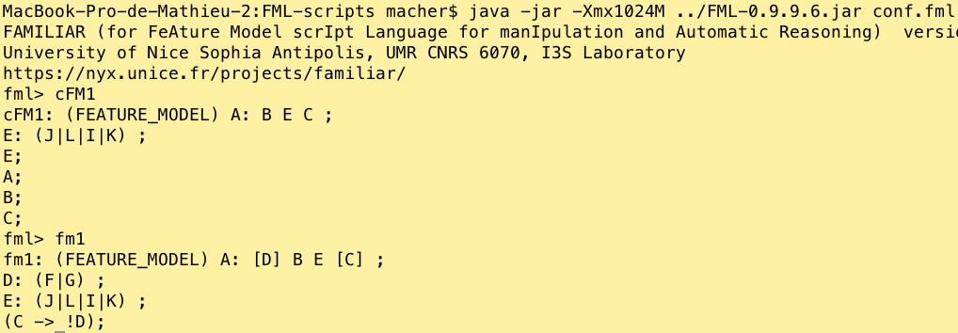
Configuration
conf.fml

Slide 24
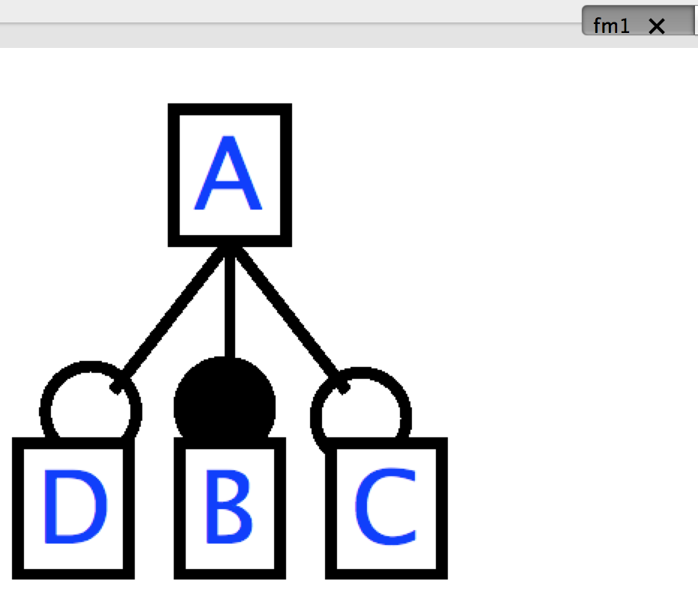
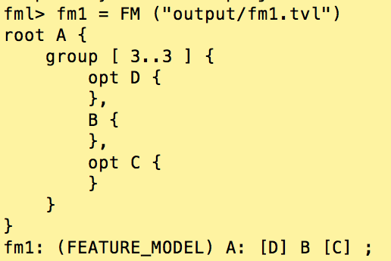

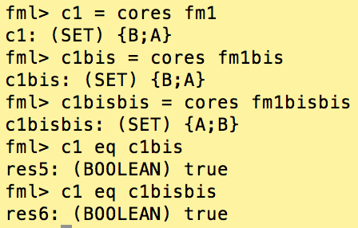
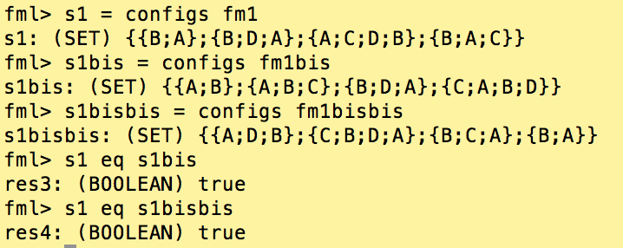
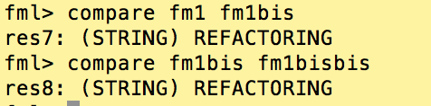
A ^
A ⬄ B ^
C => A ^
D => A
φ
FM
Notes:
Avec une image!

Slide 25
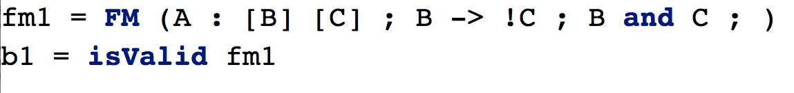

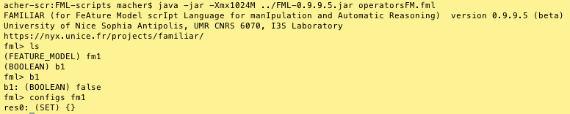
Operations for Feature Models (1)
operatorsFM.fml
φ

Slide 26
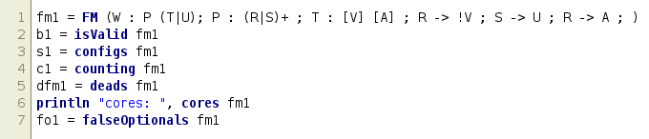
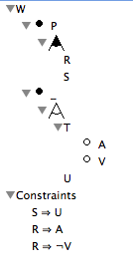
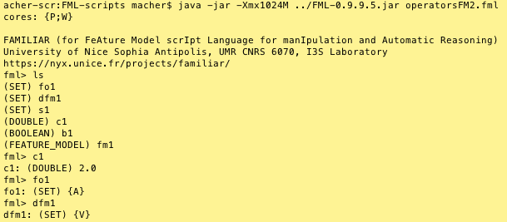
Operations for Feature Models (2)
operatorsFM2.fml
φ

Slide 27
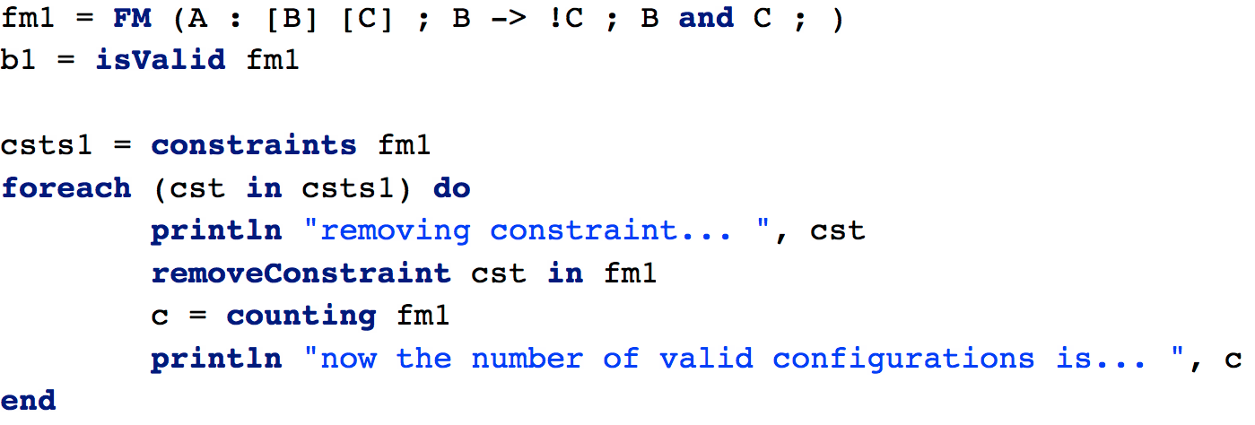
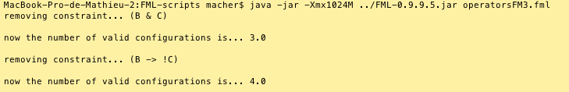
Operations for Feature Models (3)
operatorsFM3.fml

Slide 28
SoC support = Composition/Decomposition
for managing
large, complex and multiple
feature models
FORM 1998, Tun et al. 2009 (SPLC), Hartmann 2008 (SPLC), Lee et al. 2010, Czarnecki 2005, Reiser et al. 2007 (RE journal), Hartmann et al. 2009 (SPLC), Thuem et al. 2009 (ICSE), Classen et al. 2009 (SPLC), Mendonca et al. 2010 (SCP), Dunghana et al. 2010, Hubaux et al. 2011 (SoSyM), Zaid et al. 2010 (ER), She et al., 2011 (ICSE), etc.

Slide 29


Composing Feature Models (1)
aggregateBasics.fml

Slide 30



Composing Feature Models (2)
aggregate1.fml
Previous version

Slide 31






Composing Feature Models (3)
mergeMI.fml
Mathieu Acher, Philippe Collet, Philippe Lahire, Robert B. France « Comparing Approaches for Implementing Feature Model Composition » ECMFA’10

Slide 32







Comparing Feature Models
compare.fml
see also Thuem, Kastner and Batory, ICSE’09

Slide 33
Combining operators:
an example

Slide 34










Merge Intersection: Available Suppliers
Suppliers?
Products?
∩
∩
A customer has some requirements

Slide 35


In FAMILIAR
suppliersExample0.fml

Slide 36


Merge Union: Availability Checking
Yes!
Can suppliers provide all products?
∩
“compare”

Slide 37

In FAMILIAR
suppliersExample.fml

Slide 38

Merging operation: implementation issues
How to synthesise a feature model that represents the union of input sets of configurations?

Slide 39

Merging operation: semantic issues (2)
φ
Union
Intersection
Diff
How to synthesise a feature model that represents the union of input sets of configurations?

Slide 40
Merging operation: algorithm
φ
φ
φ
1
2
3
How to synthesise a feature model that represents the union of input sets of configurations?
φ
+
123
merged propositional formula
merged hierarchy
Set mandatory features
Detect Xor and Or-groups
Compute “implies/excludes” constraints
see also [Czarnecki SPLC’07 or SPLC’12]

Slide 41




Merging operation: back to hierarchy
mergeNonPC.fml
?
> configs fm4
res12: (SET) {{C;A};{A;B};{A};{A;B;C}}
Mathieu Acher, Benoit Combemale, Philippe Collet, Olivier Barais, Philippe Lahire, Robert B. France « Composing your Compositions of Variability Models » MODELS’13

Slide 42
Related Works
  Well-defined semantics
  Guarantee semantics properties by construction
  More compact feature models than reference-based techniques [Schobbens et al., 2007], [Hartmann et al., 2007]
    Easier to understand
    Easier to analyze (e.g., compare with another)
  Applicable to any propositional feature models
    Full support of propositional constraints
    Different hierarchies [Van Den Broek et al., SPLC’2010/2012]
  Syntactical strategies fail [Alves et al., 2006], [Segura et al., 2007]
see also [Acher et al., ECMFA’10 / MODELS’13]
Notes:
My contributions related to the composition of feature models is a set of operators with well-defined properties.
We guarantee semantics properties……

Slide 43
Another application of composing feature models
(purpose: automated synthesis of feature models)

Slide 44


Problem: multiple „car models“

Slide 45


Problem: multiple „car models“

Slide 46


Problem: multiple „car models“

Slide 47
Problem: multiple „car models“
#1 – top-down: specify constraints (e.g., excludes) of all model lines upfront
Two modeling approaches
#2 – bottom-up: elaborate a feature model for each model line and merge them
Notes:
TODO refaire

Slide 48


#1 top-down

Slide 49
#1 bottom-up
FM_1
merge
FM_2
FM_r
FM_3

Slide 50


#1 bottom-up (FAMILIAR)
audiMerge.fml
FM_1
merge
FM_2
FM_r
FM_3

Slide 51
Decomposition support
(and its combination with other operators)

Slide 52


Building “views” of a feature model

Slide 53
Building “views” of a feature model
Problem: given a feature model, how to decompose it into smaller feature models?
Semantics?
  What’s the hierarchy
  What’s the set of configurations?

Slide 54

A first try
Problem: You can select A3 without A5
Hierarchy and Configuration matter!
Notes:
TODO: animation with select / deselect

Slide 55
Slicing Operator
slicing criterion : an arbitrary set of features, relevant for a feature model user
slice : a new feature model, representing a projected set of configurations

Slide 56
Slicing operator: going into details projected set of configurations
fm1 = {
{A,B,C,D,E,P,R,T,U,W},
{A,B,C,F,P,S,T,U,W},
{A,B,C,D,E,P,R,T,W},
{A,B,C,F,P,S,T,V,W},
{A,B,C,F,P,S,T,U,V,W},
{A,B,C,F,P,S,T,W},
{A,B,C,D,E,P,R,T,V,W},
}
fm1 = {
{A,B,C,D,E,P,R,T,U,W},
{A,B,C,F,P,S,T,U,W},
{A,B,C,D,E,P,R,T,W},
{A,B,C,F,P,S,T,V,W},
{A,B,C,F,P,S,T,U,V,W},
{A,B,C,F,P,S,T,W},
{A,B,C,D,E,P,R,T,V,W},
}
fm1p = {
{D,E,T},
{S,T},
{D,E,T},
{S,T},
{S,T},
{S,T},
{D,E,T}
}
fm1p = {
{D,E,T},
{S,T},
}
Notes:
“existential quantification” => details

Slide 57
Slicing operator: going into details
synthesizing the corresponding feature model
φ
1
existential quantification of features not included in the slicing criterion
φ
+
T
s1
S
E
D
fm1p = {
{D,E,T},
{S,T}
}
Mathieu Acher, Philippe Collet, Philippe Lahire, Robert B. France « Separation of Concerns in Feature Modeling: Support and Applications » AOSD’12
Notes:
“existential quantification” => details

Slide 58

Slicing operator with FAMILIAR (1)
slicingOp2.fml
Notes:
“existential quantification” => details

Slide 59

slicingOp.fml
Slicing with FAMILIAR (2)

Slide 60


From marketing, customers, product management
From existing software assets (technical variability)
Metzger, Heymans et al. “Disambiguating the Documentation of Variability in Software Product Lines: A Separation of Concerns, Formalization and Automated Analysis“ (RE’07)

Slide 61


usefulness
From marketing, customers, product management
From existing software assets
realizability

Slide 62


Realizability checking
1
aggregate
2
slice (“realizable part”)
φ
{{V1,V3,V2,VP1},
{V1,VP1},
{V3,VP1},
{VP1}}
compare
3
merge diff (“unrealizable products”)
4
Mathieu Acher, Philippe Collet, Philippe Lahire, Robert B. France « Separation of Concerns in Feature Modeling: Support and Applications » AOSD’12
Notes:
CAiSE

Slide 63


With FAMILIAR
realizibility.fml

Slide 64
Advanced topics

Slide 65

Revisiting Merge:
Aggregate + Slice

Slide 66



Revisiting Aggregate,
Merge and Slice:
mergeWithAggregateMI.fml
Mathieu Acher, Benoit Combemale, Philippe Collet, Olivier Barais, Philippe Lahire, Robert B. France « Composing your Compositions of Variability Models » MODELS’13

Slide 67

Mathieu Acher, Benoit Combemale, Philippe Collet, Olivier Barais, Philippe Lahire, Robert B. France « Composing your Compositions of Variability Models » MODELS’13

Slide 68




A ^
A ⬄ B ^
C => A ^
D => A
Feature Model Synthesis Problem
[Czarnecki et al., SPLC’07]
[She et al., ICSE’11]
[Andersen et al., SPLC’12]
φ
FM
Notes:
Avec une image!

Slide 69
φ
« How to synthesise an
accurate (w.r.t. the set of constraints/configurations)
meaningful (maintainable by a user), and
unique
feature model? »
http://familiar-project.github.com/
Notes:
Avec une image!

Slide 70

φ(SAT solvers or
Binary Decision Diagrams)
The knowledge can be:
inconsistent (e.g., root feature specified is not possible)
consistent and incomplete (i.e., synthesis algorithm needs additional information)
consistent, « partial » (e.g., not all the hierarchy is specified) and actually complete
Mathieu Acher, Patrick Heymans, Anthony Cleve, Jean-Luc Hainaut, Benoit Baudry « Support for Reverse Engineering and Maintaining Feature Models » VaMoS’13

Slide 71



#1 Reverse Engineering Scenarios
[Haslinger et al., WCRE’11], [Acher et al., VaMoS’12]
φ

Slide 72

#2 Refactoring
[Alves et al., GPCE’06], [Thuem et al., ICSE’09]
φ

Slide 73

#3 Re-Engineering Feature Models of repository
For each FM we execute the following FAMILIAR script…
… And we «compare» syntactically fm1 and fm2
    semantical comparison is not needed: we know that they are refactoring by construction (good test case though ;-))
Results:
  147 synthesised FMs (69 %) were exactly the same as input FMs ;
  40 synthesised FMs (19%) were corrections of input FMs ;
  24 synthesised FMs (12%) were different (knowledge needed)
    another set of cross-tree constraints was synthesised.
    feature group conflicts in six cases
Specification of the hierarchy is the main issue
φ

Slide 74
#1 Breathing knowledge into feature model synthesis
formal specification (consistency and completeness)
concrete syntax and tooling suport
#2 Practical applications
reverse engineering, refactoring/re-engineering of feature models
φ
FAMILIAR
« Give me a formula
and some knowledge,
I will synthesise
an accurate,
meaningful,
unique
feature model »
Automated support is highly needed (ongoing work)
http://familiar-project.github.com/
Notes:
Avec une image!

Slide 75

State-of-the-art support for assisting users:
http://tinyurl.com/OntoFMExperiments
Ontological Heuristics
Clusters of conceptually
similar features
(interactive synthesis)
Ranking list
Logical clusters
FAMILIAR console
« Breathing Ontological Knowledge into Feature Model Management »
Guillaume Bécan, Mathieu Acher, Benoit Baudry, Sana Ben Nasr

Slide 76

300+ Products Comparison Matrices in Wikipedia
« From Comparison Matrix to Variability Model: The Wikipedia Case Study »
Nicolas Sannier, Mathieu Acher, and Benoit Baudry (ASE’2013)

Slide 77












From Products to Feature Models

Slide 78
    Manual extraction of a feature model from product description(s) is not possible
    640 configurations
    (634 counter examples)
    Exact set of configurations, each configuration corresponding to at least one product

Slide 79
Automation
Each product description is encoded as a feature model
Feature models {fm1, fm2,…,fm8} are merged
fm1
fm2
fm3
fm4
fm5
fm6
fm7
fm8

Slide 80

Each product description is encoded as a feature model

Slide 81
Merging of feature models
φ
φ
φ
1
2
3
φ
+
m
merged propositional formula
merged hierarchy
Set mandatory features
Detect Xor and Or-groups
Compute “implies/excludes”

Slide 82
Feature models in the real
SPLOT repository
  more than 200 feature models reported from the literature (various domains)
Linux feature model
  worst case: more than 6300 features!
  eCos, FreeBSD, BusyBox, etc.
Automotive industry
  thousands of features
Wiki matrix
  wiki engines: ~ 2000 features
Reverse engineering procedures are emerging

Slide 83






(ongoing) Comprehensive model-based product line support
Reverse engineering
Automated Analysis
Languages, API/DSLs
Evaluation (European projects, long-term collaboration with Thales, open source systems)
83

Slide 84
?
84

